Slide 1
Liver Resection: Strategies to Protect the Remnant Liver after Major Hepatectomies
Gebhard Wagener
Columbia University Medical Center
New York, NY

Slide 2
No conflict of interest

Slide 3
Summary
Identify the patient at risk
  Preoperative
  Intra-operative signs of liver failure
Interventions
  In the OR
    Surgical
    Pharmacological and anesthetic
  Postoperative

Slide 4
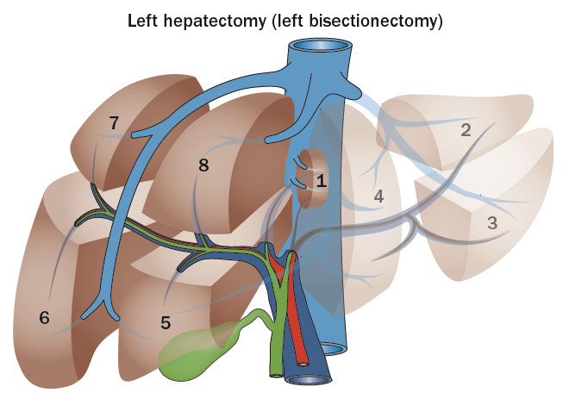
Case: Hepatecomy
65 year old man with hepatitis C cirrhosis scheduled
for left hepatectomy for hepatocellular cancer
No ascites, no encephalopathy
Total bilirubin = 2.1 mg/dl = 35.9 µmol/L
INR 1.5
Serum creatinine 1.2 mg/dL = 106.08 µmol/L
Albumin 4.1 mg/dL = 5.95 µmol/L
Nature Reviews Clinical Oncology 11, 446–459 (2014)

Slide 5
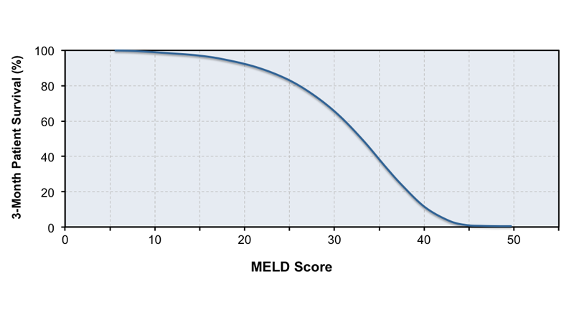
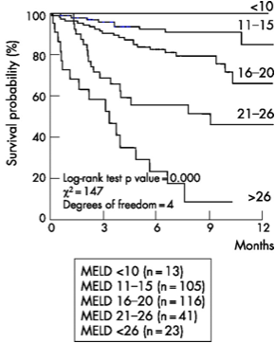
How sick is my patient?
MELD score
3.78×ln[bilirubin] + 11.2×ln[INR] + 9.57×ln[creatinine]

Slide 6
How sick is my patient?
Child-Turcotte-Pugh (CTP) score
Subjective
Poor discriminatory function with more severe disease
 | 1 point | 2 points | 3 points
Total bili | (<2) | (2-3) | (>3)
Albumin | >3.5 | 2.8-3.5 | <2.8
INR | <1.7 | 1.71-2.30 | > 2.30
Ascites | None | Mild | Mod-sev
HE | None | Grade I-II | Grade III-IV
Points | Class | 1-year survival | 2-year survival
5-6 | A | 100% | 85%
7-9 | B | 81% | 57%
10-15 | C | 45% | 35%
Br J Surg. 1973 Aug;60(8):646-9

Slide 7
MELD or CTP score
CTP score:
Easier
  Child A and B usually tolerate surgery well, Child C not
Subjective
MELD score:
Better discrimination
  Especially with sicker patients /higher scores
Preferential for patients with kidney disease
  Patients on dialysis without liver disease have a MELD score = 20
Other factors
Portal hypertension, ascites, hyponatremia, overall condition
Notes:
1% increase of mortality/MELD point if MELD < 20; 2% if > 20

Slide 8
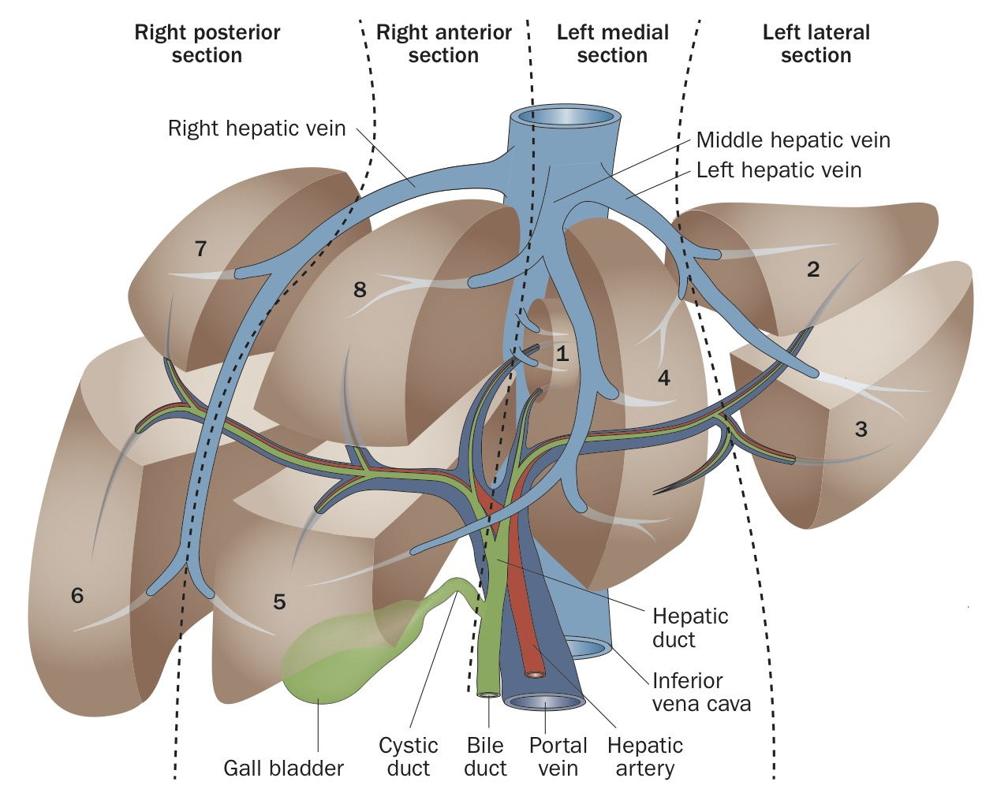
Types of resection
Cantlie’s line

Slide 9
Types of resection: Right Hepatecomy
Segments 5-8
  To the right of the MHV
+/- Caudate lobe
Anatomic
  MHV preserved
Functional
  MHV resected
55-60% of liver volume

Slide 10
Types of resection: “Trisegmentectomy”
Better: Extended Right Segmentectomy
Segment 5-8 and 1 and 4
  Five, not three segments
60-70% of liver volume

Slide 11
Types of resection: Left Hepatectomy
Segments 2-4
30-45 % liver volume resected

Slide 12
Types of resection: Left Lateral sectionectomy
Segments 2 and 3
25-30 % liver volume resected

Slide 13
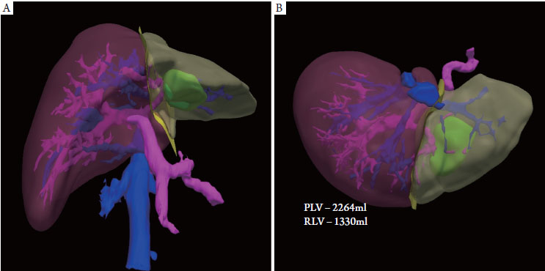
Assessment of the residual liver
Remnant liver volume to total liver volume (RLV/TLV ratio)
  Commonly used for resection
  20-25% considered safe with healthy liver
Remnant liver to body volume (RLV/BW ratio)
  For liver donations

Slide 14
Assessment of the residual liver
Contraindications for resection
Any Child C
Child B: RLV/TLV ratio < 40%
Child A: RLV/TLV ratio < 30% (?)
Mortality Child A: 14% vs. 1% without cirrhosis
Am J Surg. 1995 Jan;169(1):28-34

Slide 15
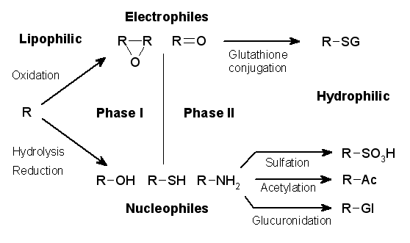
Liver function tests
Phase II glucuronidation
Total bilirubin is a late marker: Not very sensitive to hypoxia
  80 % of patients with cirrhosis have an increased hepatic vein pressure gradient/portal hypertension at the time of diagnosis
Phase I oxidation
Requires oxygen
More sensitive to injury
Not easily assessed
Notes:
Figure 21-2 Schematic summary of the pathway of bilirubin (labeled as Bili and also shown in brown circles) transport and metabolism. Bilirubin (Bili) is produced from metabolism of heme, primarily in the spleen, and is transported to the liver bound to albumin. It enters the hepatocyte by binding to a transporter protein (red crescents) and crosses the cell membrane (circled 1 in the figure) thus entering the cell. It binds to Y and Z proteins (not shown) and then to ligandin for transport to the smooth endoplasmic reticulum (SER). In the SER, bilirubin is conjugated to glucuronic acid by UDP-glucuronyl transferase 1 (circled 2 in the figure), producing mono- and diglucuronides of bilirubin – Bili-Gu and Bili-(Gu)₂. Conjugated bilirubin is then secreted into the canaliculi (circled 3 in the figure) by the ATP-binding cassette transporter protein MRP2/cMOAT/ABCC2, shown as blue crescents in the figure. In overproduction disease (A), such as in hemolytic anemia, unconjugated bilirubin is produced at rates that exceed the ability of the liver to clear it, leading to a usually transient increase in unconjugated bilirubin in serum. In both Gilbert's and the Crigler–Najjar syndromes, mutations in the gene encoding UDP glucuronyl transferase (UDPGT1A1), shown at C in the figure, result in build-up of unconjugated bilirubin in hepatocytes and ultimately in serum. In Gilbert's syndrome, there may also be a defect in the bilirubin transporter protein shown at B in the figure. Mutations in the MRP2/cMOAT/ABCC2 gene result in defective secretory proteins resulting in the build-up of conjugated bilirubin in hepatocytes and, ultimately, in serum, resulting in the Dubin–Johnson syndrome (D), an autosomal recessive disease. Conjugated hyperbilirubinemia is also found in the Rotor syndrome, possibly virus-induced. In adults, blockade of any of the major bile ducts, especially the common bile duct, by stones or space-occupying lesions such as tumors (E) are the most common causes of conjugated hyperbilirubinemia.

Slide 16
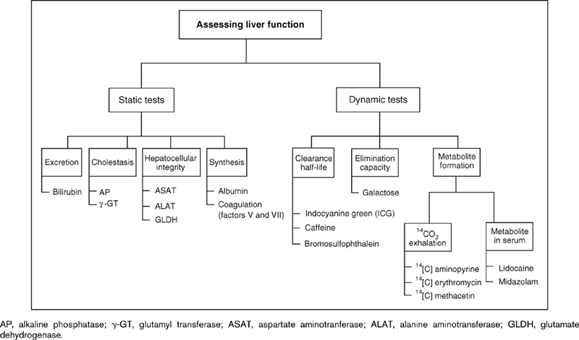
Dynamic liver function tests
Curr Opin Crit Care 2007;13(2):207–214.)

Slide 17
Dynamic liver function tests
Curr Opin Crit Care 2007;13(2):207–214.)

Slide 18
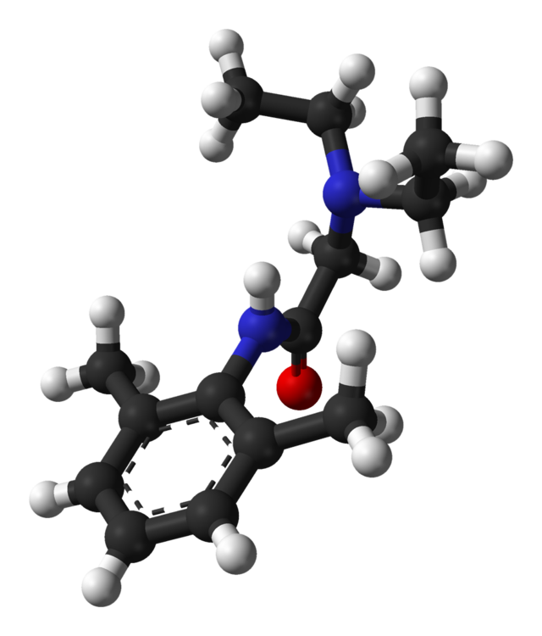
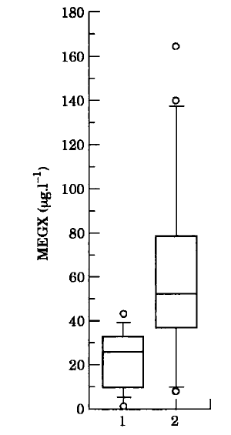
Lidocaine (MEGX) Test
Lidocaine
High hepatic extraction
Then oxidative N-dealkylation
  Main metabolite: Monoethylglycinexylidide (MEGX)
MEGX depends on liver blood flow & cytochrome P450
Studied in
Survival in ICU patients / sepsis
Donor quality
Overall survival of cirrhotics
Anaesthesia. 1995 Oct;50(10):850-4.

Slide 19
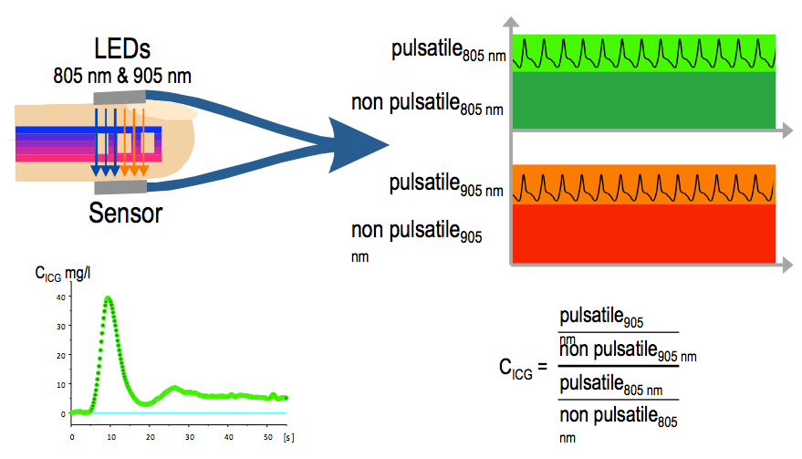
ICG clearance
Indocyanine green (ICG)
Cyanine dye
Eliminated rapidly by hepatic uptake -> biliary excretion
Absorption spectrum ~ 800nm (close to de-oxygenated Hb)
Duration of “desaturation” correlates with liver blood flow
% ICG eliminated /min (ICG plasma disappearance rate)
Normal 18% / min

Slide 20
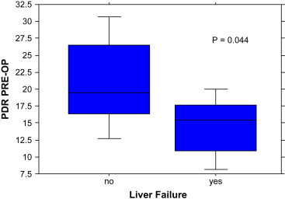
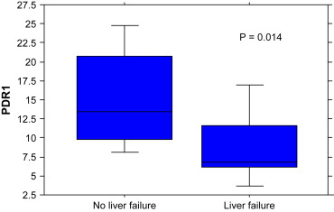
ICG clearance predicts liver dysfunction after hepatectomy
ICG clearance on day 1 correlated with total bilirubin on days 1, 5 and 10
Eur J Surg Oncol. 2009 Sep;35(9):957
Notes:
Perioperative use of the LiMON method of indocyanine green elimination measurement for the prediction and early detection of post-hepatectomy liver failure.
de Liguori Carino N, O'Reilly DA, Dajani K, Ghaneh P, Poston GJ, Wu AV.
Source
Supra-Regional Hepatobiliary Unit, University Hospital Aintree, Liverpool, L9 7AL, UK. nicola.dlc@gmail.com
Abstract
INTRODUCTION:
A non-invasive liver function monitoring system, the LiMON, has been developed that measures indocyanine green (ICG) elimination by pulse spectrophotometry. The aim was to assess the relationship between pre and post-operative ICG plasma disappearance rate (ICG PDR %/min) values and the onset of post-hepatectomy liver dysfunction.
METHODS:
37 patients scheduled for major liver resections were selected. None had chronic liver disease. IGC PDR was measured preoperatively and on days 1, five and 10 postoperatively. On the same day, serum liver function tests were measured.
RESULTS:
The median preoperative and post-operative day 1 ICG PDR for the patients who developed liver dysfunction was significantly lower compared to those who did not (p=0.044, p=0.014). Significant correlation was found between ICG PDR measurement taken on postoperative day 1 and bilirubin level on day 1 (p=0.002), 5 (p=<0.001) and 10 (p=0.001). The same was true for ICG PDR on post-operative day 1 and albumin level on day 5 and 10 (p=0.003, p<0.001).
DISCUSSION:
LiMON ICG PDR measured by pulse spectophotometry is a quick, non-invasive and reliable liver function test in patients undergoing liver resection that aids in the prediction and early detection of post-hepatectomy liver dysfunction.

Slide 21
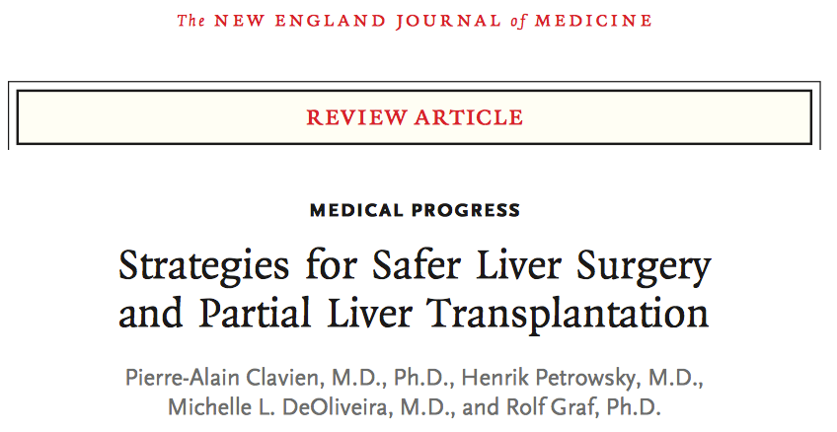
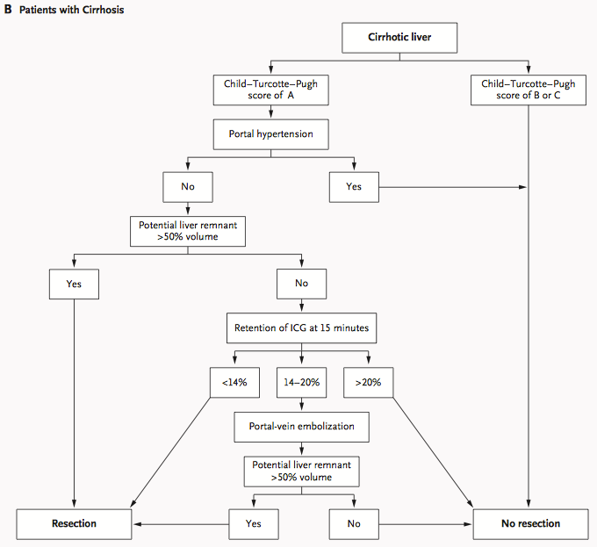
N Engl J Med 2007;356:1545-59.

Slide 22
Our patient
Child A
Left hepatcetomy
N Engl J Med 2007;356:1545-59.

Slide 23
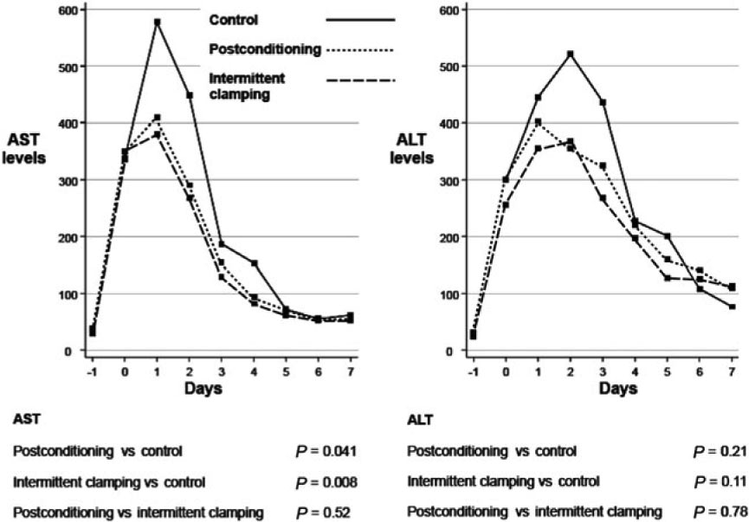
Safe liver resection
Liver resection can be performed safely:
Preoperative portal vein embolization
Avoid liver ischemia / porta hepatis clamp (Pringle)
  Selective occlusion?
  Pre-ischemic conditioning / intermittent occlusion?
Low CVP technique?
Pharmacological pre/post conditioning?
Experienced surgeon / anesthesiologist
Ann Surg. 2012 Nov;256(5):837-

Slide 24
What can we do?
Facilitate surgery
Limit Ischemic Injury
Treat / Ameliorate Injury

Slide 25
What can we do?
Facilitate surgery
“Low CVP”
Limit Ischemic Injury
Effect of Pringle (inflow obstruction)
Treat / Ameliorate Injury
Inhalational anesthetics
Portal inflow modification
N-Acetyl cysteine

Slide 26
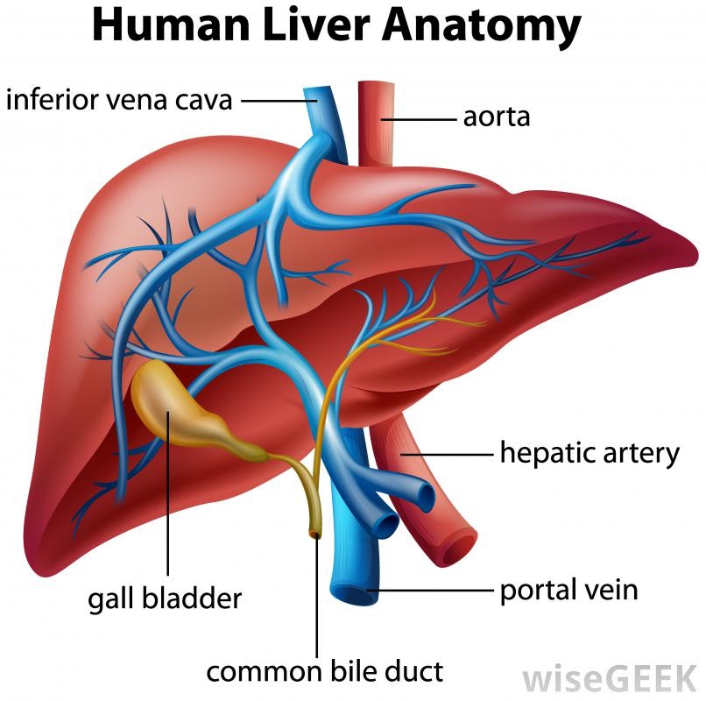
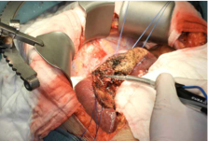
Facilitate surgery
“Low CVP” technique (misnomer)
High CVP increases back bleeding
Surgeon needs to identify / ligate
(Portal) veins, arteries, bile ducts
  CUSA / Clamp / “Ligasure”
Bleeding causes more bleeding
HPB, 2007; 9: 166 173

Slide 27
Facilitate surgery: Low CVP
Evidence?
Meta-analysis: 8 studies with 40-192 subjects each
  339 patients low CVP and 342 “normal” CVP
Interventions:
  Anesthetic: Fluid restriction, epidural, vasodilators and/or diuretics
  Surgical: IVC clamping /total or selective vascular hepatic exclusion
Endpoints:
  Composite end-point: “systemic complications”
  Blood loss
HPB 2015, 17, 863–871

Slide 28
Low CVP: Meta-analysis
Endpoints
Composite end-point: “systemic complications”
No difference
HPB 2015, 17, 863–871

Slide 29
Low CVP: Meta-analysis
Endpoints
Composite end-point: “systemic complications”
No difference
Blood loss / EBL
Less EBL with low CVP group
Weighted mean difference (WMD): 308.63 ml P < 0.001
Anesthetic interventions: less EBL
WMD = 406.26 ml, P = <0.001
Surgical intervention: No difference (IVC clamping)
WMD = 88.7 ml, P = 0.330
HPB 2015, 17, 863–871

Slide 30
Low CVP: Meta-analysis
Endpoints
Composite end-point: “systemic complications”
No difference
Blood loss / EBL
Less EBL with low CVP group
Weighted mean difference (WMD): 308.63 ml (95% CI 474.67, 142.58) P < 0.001
Anesthetic interventions: less EBL
WMD = 406.26 ml, CI 499.77, 321.76, P = <0.001
Surgical intervention: No difference (IVC clamping
WMD = 88.7 ml, CI 268.02, 90.7, P = 0.330, I2 = 0%).
Conclusion
“Low CVP” reduces EBL
More does not help more
Use common sense:
Depends on co-morbidities and type of vascular clamping
HPB 2015, 17, 863–871

Slide 31
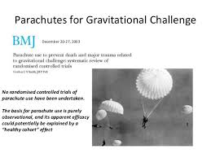
Low CVP: Meta-analysis
Endpoints
Composite end-point: “systemic complications”
No difference
Blood loss / EBL
Less EBL with low CVP group
Weighted mean difference (WMD): 308.63 ml (95% CI 474.67, 142.58) P < 0.001
Anesthetic interventions: less EBL
WMD = 406.26 ml, CI 499.77, 321.76, P = <0.001
Surgical intervention: No difference (IVC clamping
WMD = 88.7 ml, CI 268.02, 90.7, P = 0.330, I2 = 0%).
Conclusion
“Low CVP” reduces EBL
More does not help more
Use common sense:
Depends on co-morbidities and type of vascular clamping
HPB 2015, 17, 863–871

Slide 32
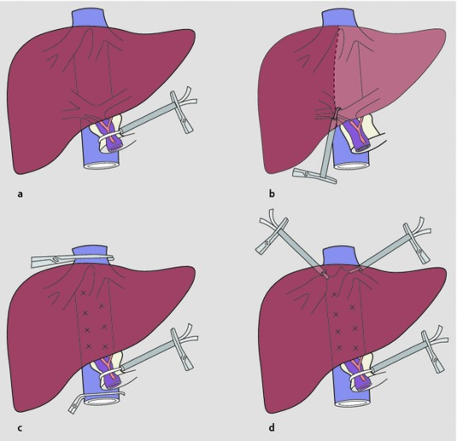
Vascular occlusion
Reduces blood loss during dissection
Pringle maneuver
  Hepatic inflow occlusion
Complete hepatic occlusion
  Supra-/infrahepatic cava
  Usually not tolerated without fluids/pressors
Chirurg 2007 · 78:761–774)

Slide 33
Vascular occlusion: Pringle maneuver
Does it work?:
RCT: Intermittent versus no Pringle (63 patients each)
370 (50 – 3600) ml in the IPM group versus 335 (40–3160) ml in the NPM group (P = 1·000).
No differences
  Duration of surgery
  Liver transection time
Postoperative serum AST higher in the IPM group
More postoperative complications in the IPM group
  41 % versus 24 %; P = 0·036
British Journal of Surgery 2012; 99: 1203–1209

Slide 34
Vascular occlusion: Pringle maneuver
Does it work?:
RCT: Intermittent versus no Pringle (63 patients each)
370 (50 – 3600) ml in the IPM group versus 335 (40–3160) ml in the NPM group (P = 1·000).
No differences
  Duration of surgery
  Liver transection time
Postoperative serum AST higher in the IPM group
More postoperative complications in the IPM group
  41 % versus 24 %; P = 0·036
Conclusion
Not: Pringle does not work
But: Choose the right patients for Pringle
  (Not for everyone)
British Journal of Surgery 2012; 99: 1203–1209

Slide 35
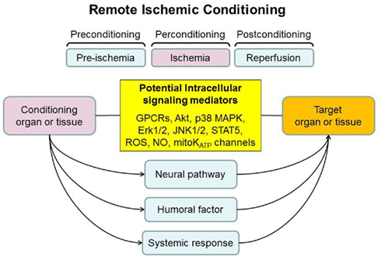
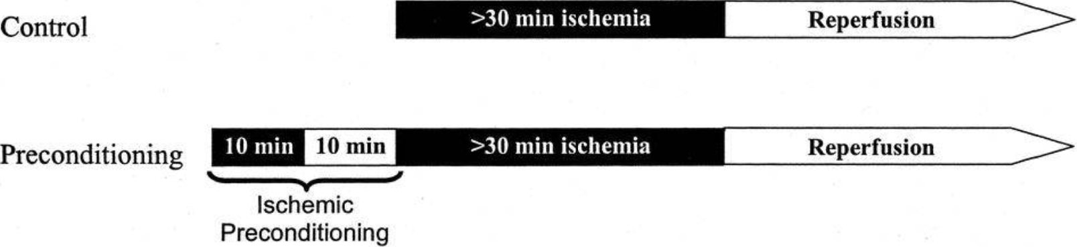
Vascular occlusion
Pre-ischemic conditioning
Ann Surg. 2003 Dec; 238(6): 843–852.

Slide 36
Vascular occlusion
Pre-ischemic conditioning
Observational data
Ann. Surg. August 2000

Slide 37
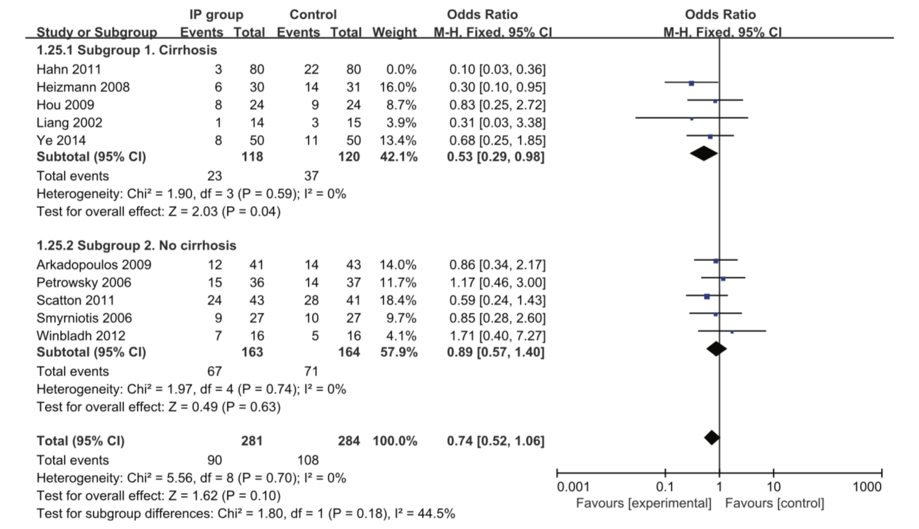
Vascular occlusion
Pre-ischemic conditioning: meta-analysis
13 randomized trials
Medicine (2017) 96:48(e8217)

Slide 38
Vascular occlusion
Pre-ischemic conditioning: meta-analysis
13 randomized trials
Subgroup cirrhosis
Small effect
Subgroup no cirrhosis
No effect
Overall
Effect???
Medicine (2017) 96:48(e8217)

Slide 39
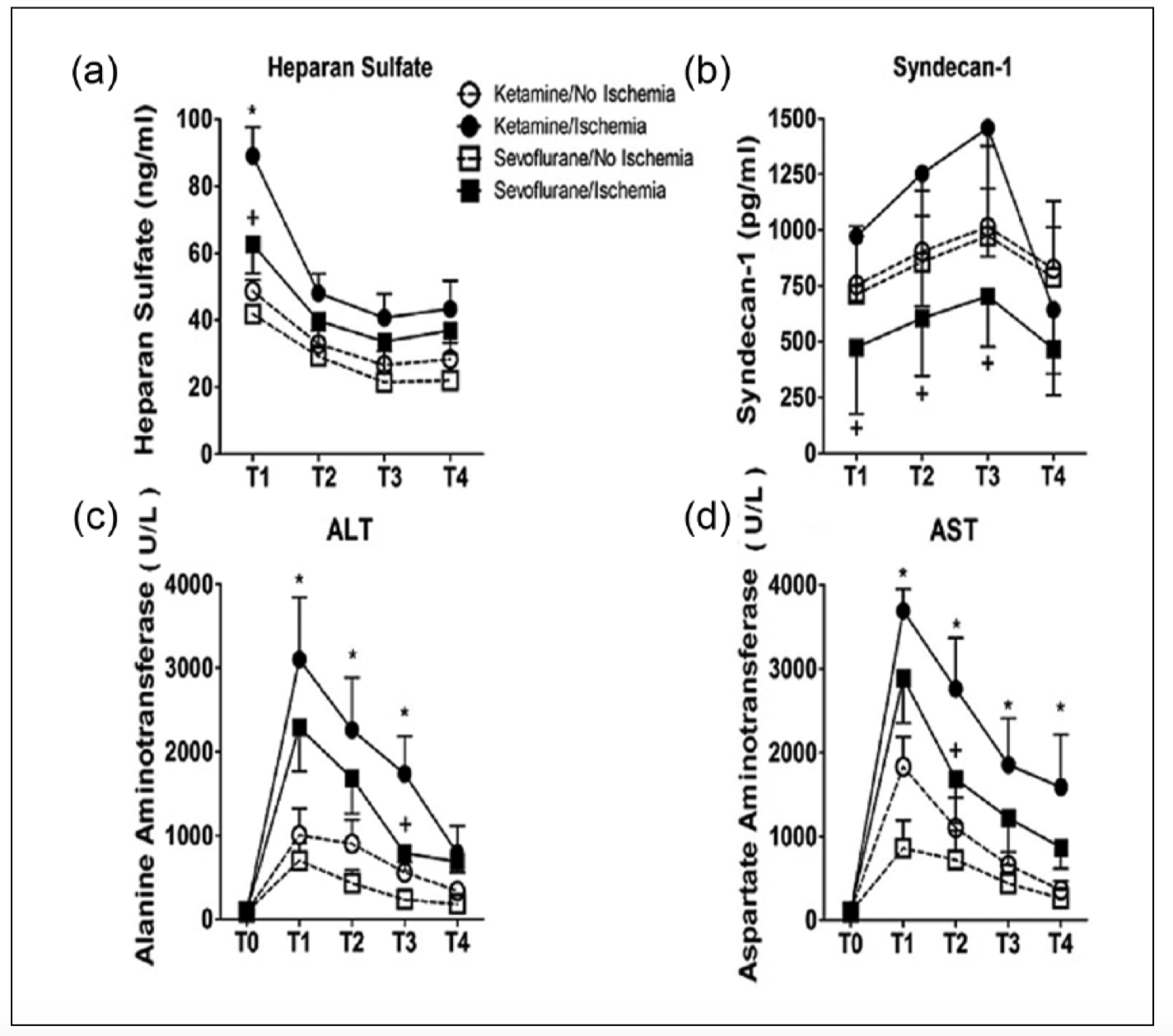
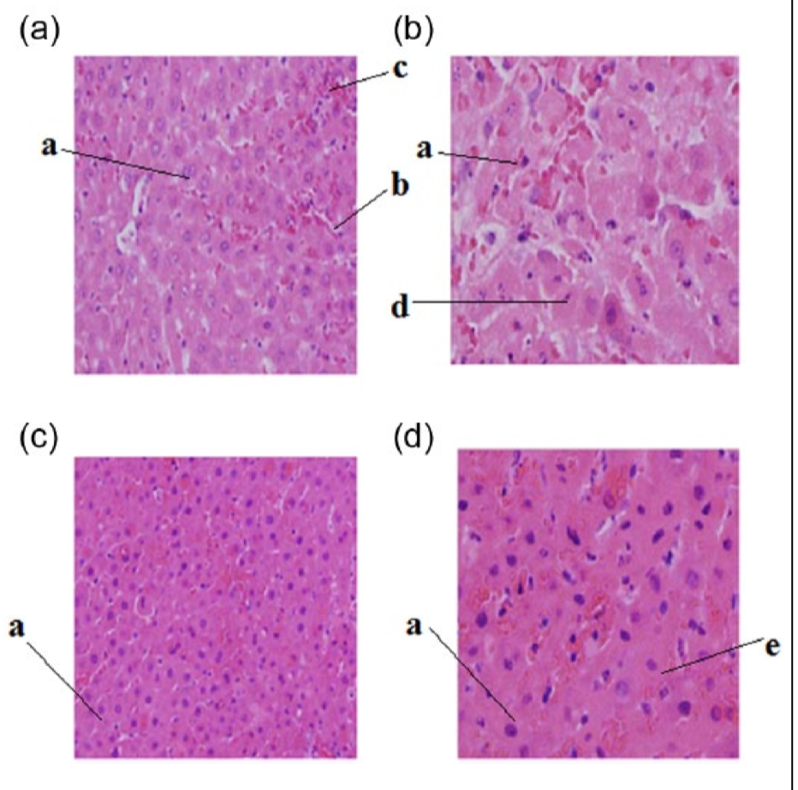
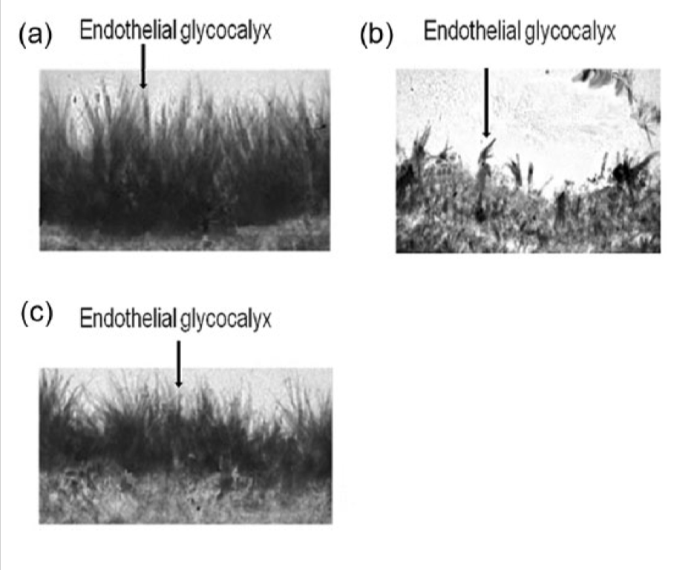
Do inhalational anesthetics protect?
Exposure to sevoflurane ameliorates hepatic ischemia-reperfusion injury
Preserved glucocalyx
(In mice)
Ketamine
Ketamine + I/R
Ketamine
Sevoflurane + I/R
Sevoflurane
Endothelial
Glycocalyx
International Journal of Immunopathology and Pharmacology 2016, Vol. 29(2) 300–307

Slide 40
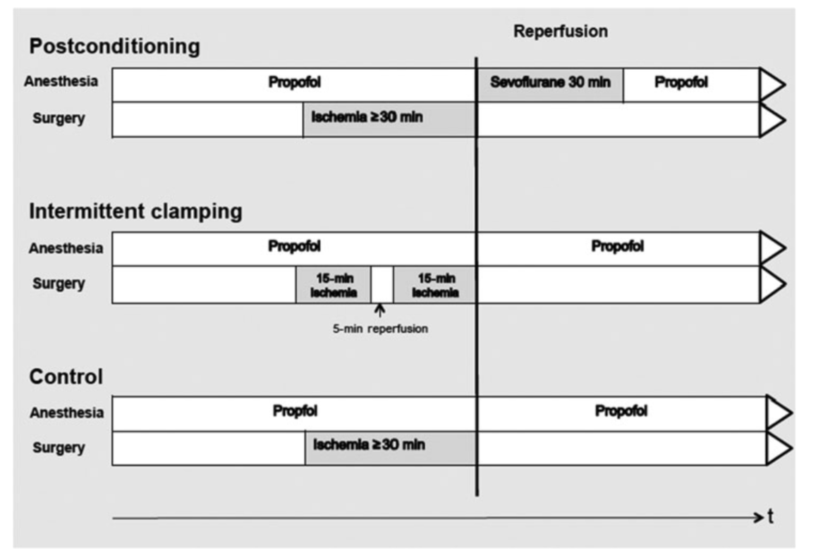
Inhalational anesthetics / Post-conditioning
Three-arm RCT
Sevoflurane (n=48)
Intermittent clamping (n=50)
No intervention (n-17)
Ann Surg. 2012 Nov;256(5):837-44;
Notes:
Objectives: To elucidate the possible organ-protective effect of pharmaco- logical postconditioning in patients undergoing liver resection with inflow occlusion.
Background: Inflow occlusion reduces blood loss during liver transection in selected patients but is potentially harmful due to ischemia-reperfusion injury. Preventive strategies include the use of repetitive short periods of ischemia interrupted by a reperfusion phase (intermittent clamping), appli- cation of a short period of ischemia before transection (ischemic precon- ditioning), or pharmacological preconditioning before transection. Whether intervention after resection (postconditioning) may confer protection is unknown.
Methods: A 3 arm, prospective, randomized trial was designed for patients undergoing liver resection with inflow occlusion to compare the effects of pharmacological postconditioning with the volatile anesthetic agent sevoflu- rane (n = 48), intermittent clamping (n = 50), or no protective intervention (continuous inflow occlusion, n = 17). Endpoints included peak serum as- partate transaminase level, postoperative complications, and hospital stay. All patients were intravenously anesthetized with propofol. In patients with post- conditioning, propofol infusion was stopped upon reperfusion and replaced with sevoflurane for 10 minutes.
Results: Compared with the control group, both postconditioning (P = 0.044) and intermittent clamping (P = 0.015) significantly reduced aspar- tate transaminase levels. The risk of complications was significantly de- creased by postconditioning, odds ratio, 0.08 [95% confidence interval (CI), 0.02–0.36; P = 0.001]) and intermittent clamping, odds ratio, 0.50 [95% CI, 0.26–0.96; P = 0.038], compared with controls. Both interventions re- duced length of hospital stay, postconditioning −4 days [95% CI, −6 to −1; P = 0.009], and intermittent clamping −2 days, [95% CI, −4 to 0; P = 0.019].
Conclusions: Pharmacological postconditioning reduces organ injury and postoperative complications. This easily applicable strategy should be used in patients with prolonged continuous inflow occlusion.

Slide 41
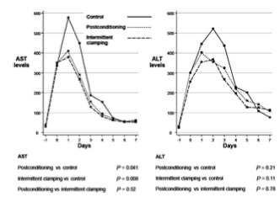
Inhalational anesthetics / Post-conditioning
Three-arm RCT
Sevoflurane (n=48)
Intermittent clamping (n=50)
No intervention (n-17)
With any intervention:
Lower AST / ALT
Lower risk of complications
Lower length of hospital stay
Ann Surg. 2012 Nov;256(5):837-44;
Notes:
Objectives: To elucidate the possible organ-protective effect of pharmaco- logical postconditioning in patients undergoing liver resection with inflow occlusion.
Background: Inflow occlusion reduces blood loss during liver transection in selected patients but is potentially harmful due to ischemia-reperfusion injury. Preventive strategies include the use of repetitive short periods of ischemia interrupted by a reperfusion phase (intermittent clamping), appli- cation of a short period of ischemia before transection (ischemic precon- ditioning), or pharmacological preconditioning before transection. Whether intervention after resection (postconditioning) may confer protection is unknown.
Methods: A 3 arm, prospective, randomized trial was designed for patients undergoing liver resection with inflow occlusion to compare the effects of pharmacological postconditioning with the volatile anesthetic agent sevoflu- rane (n = 48), intermittent clamping (n = 50), or no protective intervention (continuous inflow occlusion, n = 17). Endpoints included peak serum as- partate transaminase level, postoperative complications, and hospital stay. All patients were intravenously anesthetized with propofol. In patients with post- conditioning, propofol infusion was stopped upon reperfusion and replaced with sevoflurane for 10 minutes.
Results: Compared with the control group, both postconditioning (P = 0.044) and intermittent clamping (P = 0.015) significantly reduced aspar- tate transaminase levels. The risk of complications was significantly de- creased by postconditioning, odds ratio, 0.08 [95% confidence interval (CI), 0.02–0.36; P = 0.001]) and intermittent clamping, odds ratio, 0.50 [95% CI, 0.26–0.96; P = 0.038], compared with controls. Both interventions re- duced length of hospital stay, postconditioning −4 days [95% CI, −6 to −1; P = 0.009], and intermittent clamping −2 days, [95% CI, −4 to 0; P = 0.019].
Conclusions: Pharmacological postconditioning reduces organ injury and postoperative complications. This easily applicable strategy should be used in patients with prolonged continuous inflow occlusion.

Slide 42
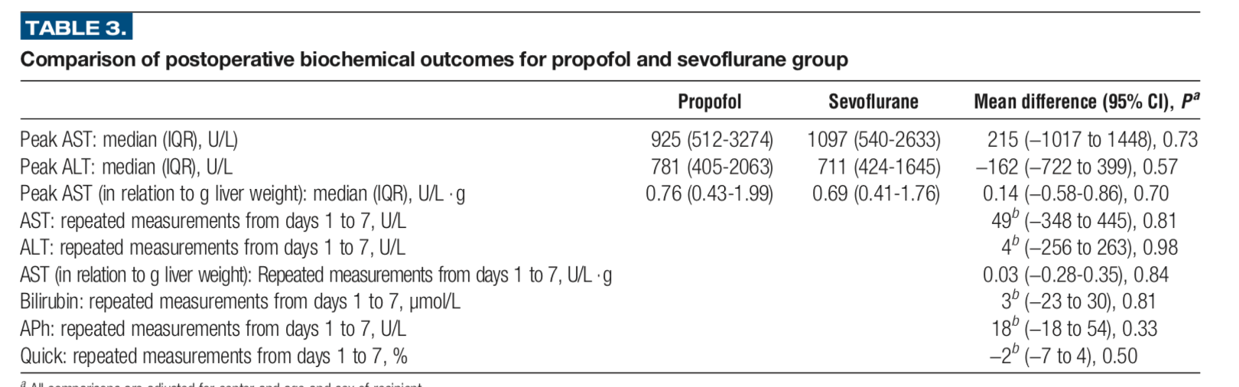
Inhalational anesthetics protect?
Multicenter RCT in liver transplantation
Propofol (n = 48) versus sevoflurane (n = 50) for the duration of surgery
No difference in biomarkers of ischemia (AST, ALT…)
Transplantation 2015;99: 1606–1612

Slide 43
Lessons learned from
Living Donor Liver Transplants
Small for size syndrome
Too small liver graft (<0.8 % body weight)
Results in acute liver failure
  Similar to liver failure after resection
Caused by portal overflow
Can be treated by portal inflow modification
  Pharmaceutical
  Surgical

Slide 44
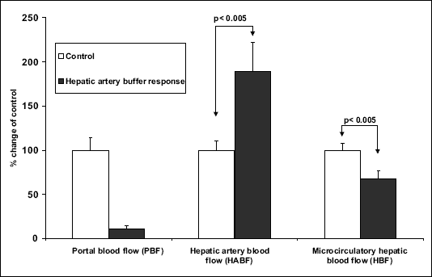
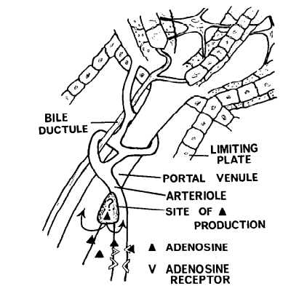
Hepatic artery buffer response
Hepatic artery flow
Portal flow
Mechanism of HA buffer:
Vasodilatory Adenosine (NO) washed away by PV flow
J Physiol Pharmacol 2005 56-133

Slide 45
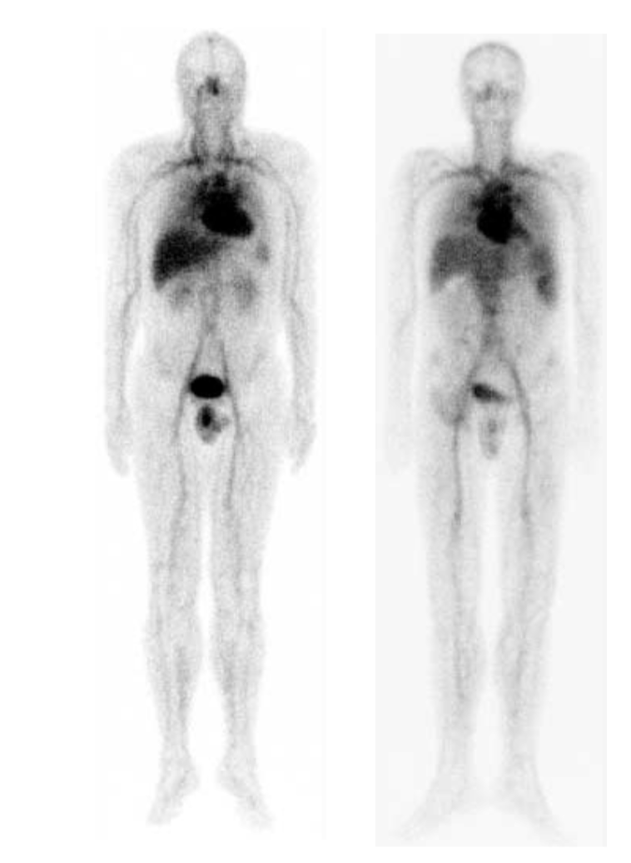
Increased Splanchnic Flow
“Splanchnic Steal”
Systemic vasodilation
Portal HTN
Splanchnic hyperemia
Healthy
Cirrhotic
(%) | Normal | Liver failure
Thorax | 27.3 | 24.7
Abdomen | 29.7 | 37.7
Liver | 11.4 | 12.8
Splanchnic | 18.2 | 25
Other | 2.3 | 5.2
Aliment Pharmacol Ther 2002; 16 (Suppl. 5): 12–23.
Notes:
Figure 1. Blood volume distribution in a healthy subject (left) and in a patient with cirrhosis (right), as illustrated by whole-body scintigraphy with 99mTc-labelled human albumin ⁄ red blood cells. Absolute regional blood volumes can be determined from regional radioactivity relative to total radioactivity and total blood volume as determined by an indicator dilution technique. From Kiszka- Kanowitz et al.6

Slide 46
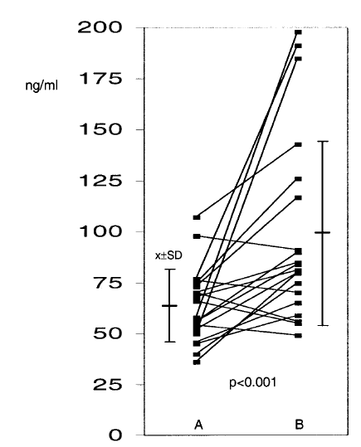
HA dilation with adenosin increases lidocaine metabolism (monoethylglycinxylidide
- MEGX)
HEPATOLOGY 2003;37:385
Hepatic artery dilation improves liver function

Slide 47
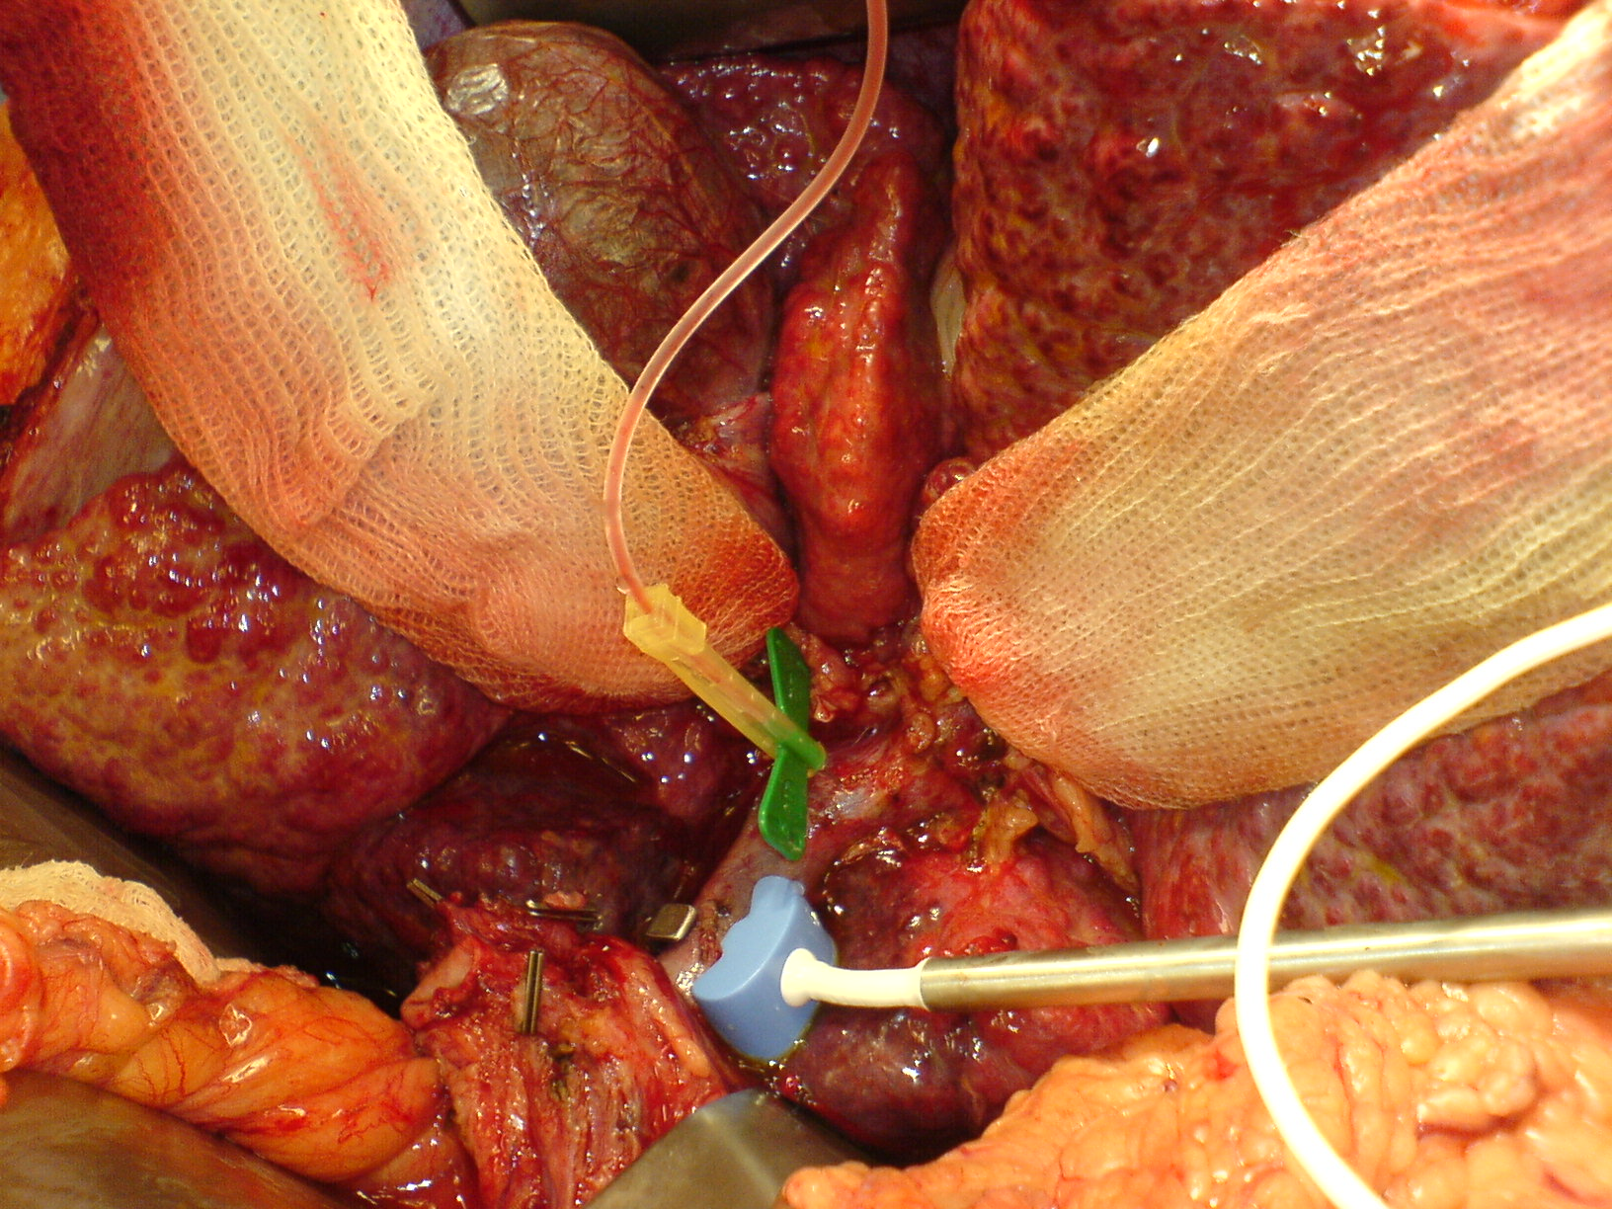
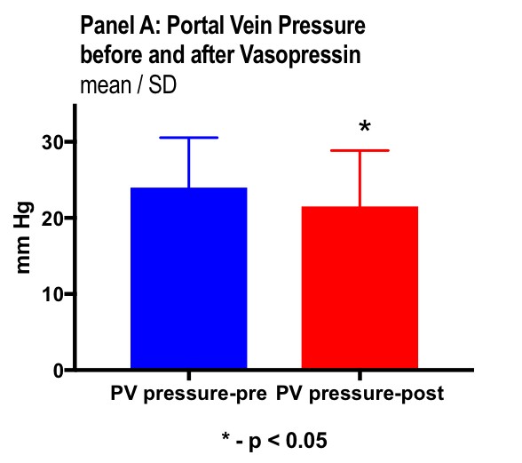
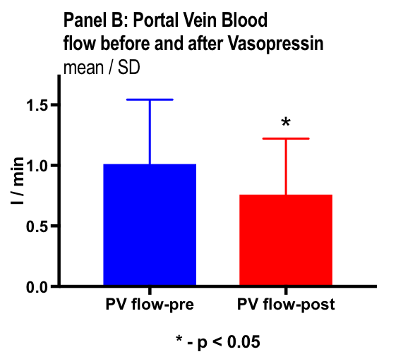
Effect of Vasopressin levels in liver failure
Simultaneous measurements in 16 patients
Portal vein pressure
Portal vein flow
Hemodynamics
Portal vein pressure
Portal vein flow
Portal vein flow/Cardiac output ratio
Liver Tx 2008;14-1664

Slide 48
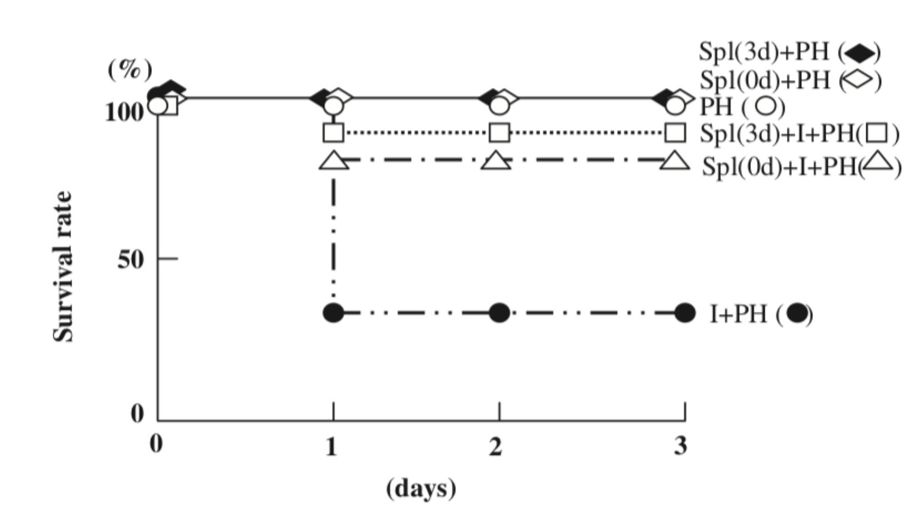
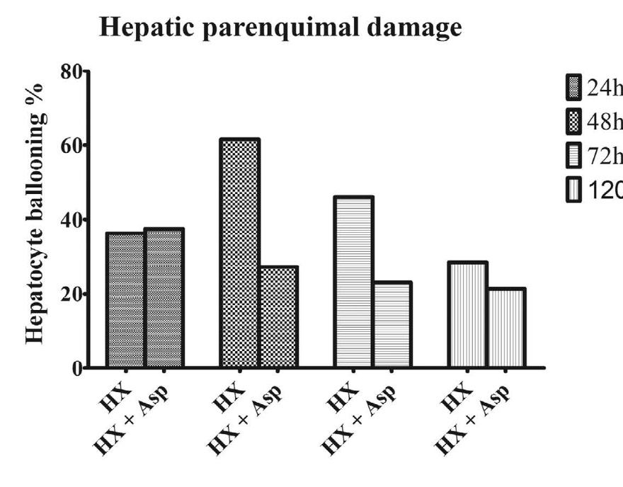
Splenic artery ligation
Now also for hepatectomy?
Survival after 2/3 hepatectomy
With Pringle
With Pringle and Splenic artery ligation
Splenic artery ligation in rats causes les hepatic injury after major hepatectomy
Liver International ISSN 1478-3223
Scientific RepoRts | 6:34731

Slide 49
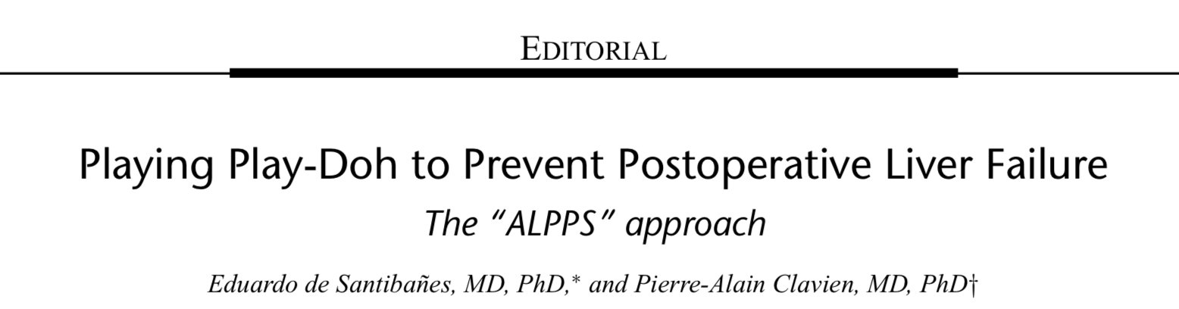
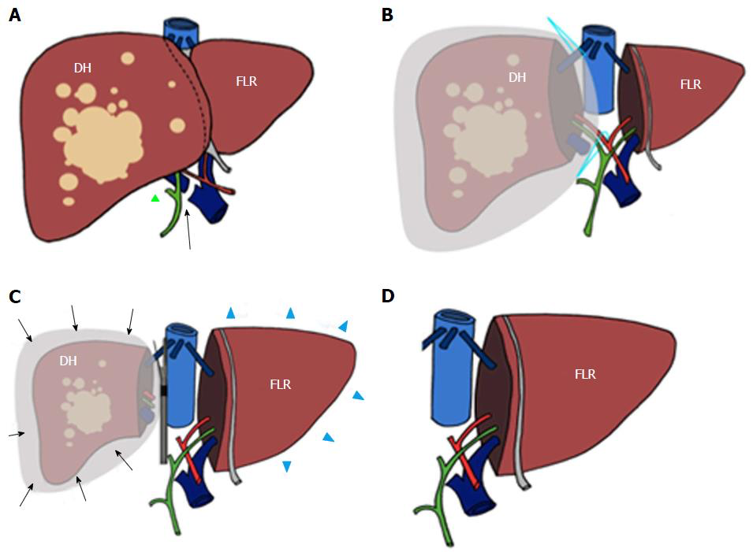
ALPPS
Annals of Surgery Volume 255, Number 3, March 2012
Staged Staged resection
1st Stage: dissection and unilateral portal vein ligation
2nd Stage: Completion resection after 7-10 days
Rapid
World J Hepatol. Jun 8, 2017

Slide 51
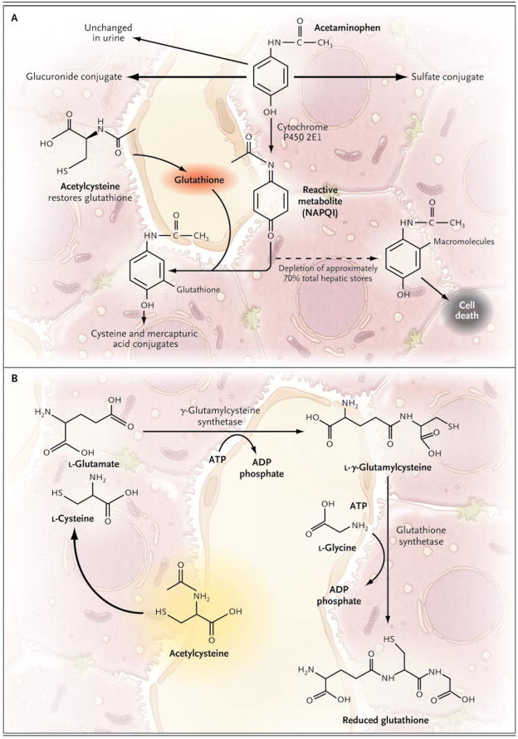
N-Acetylcysteine
Antioxdidant
Scavenges reactive oxygen species
Modulates NO synthesis during cell stress
Replaces Glutathion depletion in Tylenol overdose
(Relatively) cheap and easy
Some (promising) studies in non-tylenol acute liver failure
N Engl J Med. 2008 Jul 17; 359(3): 285–292.

Slide 52
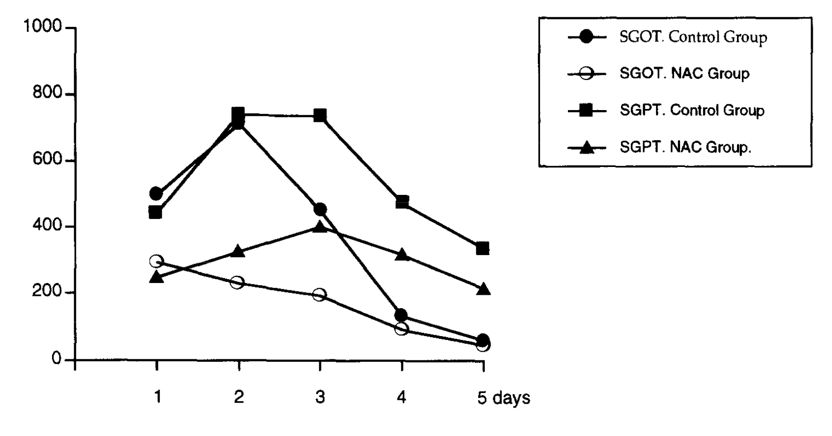
N-Acetylcysteine for liver Tx
1991-1995: “Comparative study” (retrospective?)
25 donors received 6 g of NAC >1 hour before procurement
37 controls
  Bile production was greater in the NAC group
  Less rejection
  Initial poor function: 5/37 controls versus 0/25 NAC: p =.0552
Transplantation Proceedings, 29, 3350

Slide 53
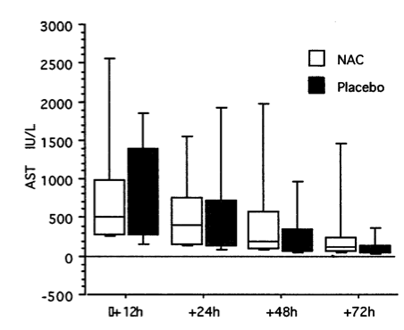
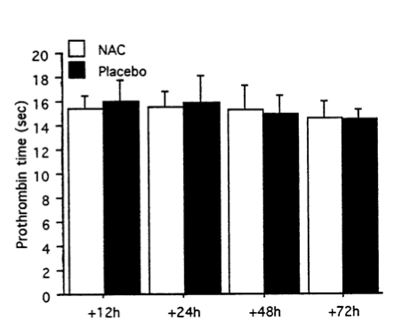
N-Acetylcysteine for liver Tx
Prospective randomized placebo-controlled study
30 patients NAC versus 30 controls
  150 mg/kg during anhepatic phase, then 50 mg/kg x 4hours, then 100 mg/kg x 16 hours.
.
AST
PT
Liver Transplantation and Surgery, Vol 4, No 2 (March), 1998: pp 152-157

Slide 54
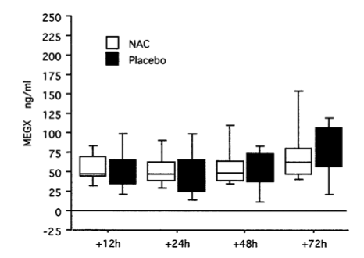
N-Acetylcysteine for liver Tx
Prospective randomized placebo-controlled study
30 patients NAC versus 30 controls
  150 mg/kg during anhepatic phase, then 50 mg/kg x 4hours, then 100 mg/kg x 16 hours.
.
MEGX-Lidocaine metabolism
Liver Transplantation and Surgery, Vol 4, No 2 (March), 1998: pp 152-157

Slide 55
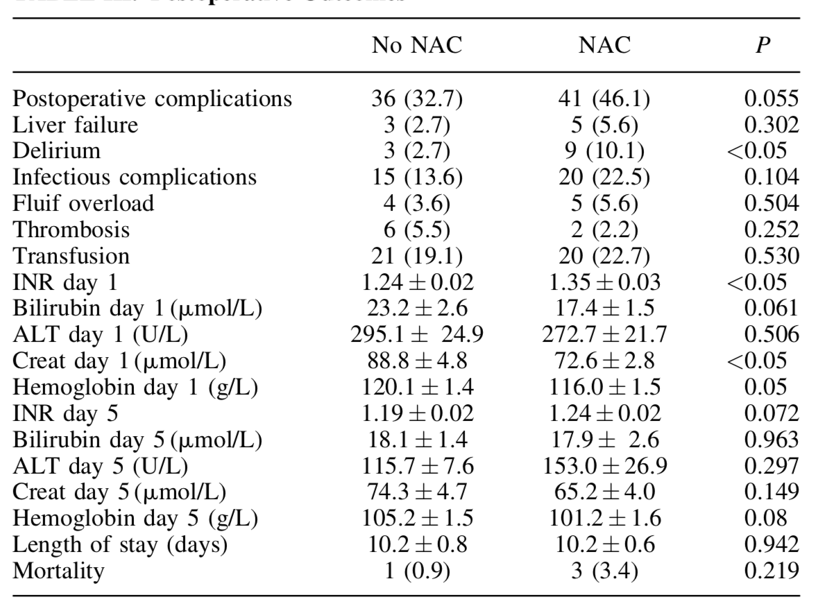
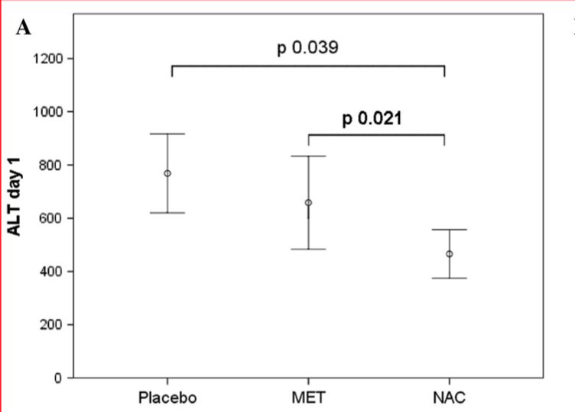
N-Acetylcysteine for liver resections?
Very little evidence: only 2 RCTs
NAC immediately post surgery
96 NAC, 110 SMT
No difference in any endpoints
NAC immediately before Pringle
16 NAC, 16 SMT, 16 methylpred
Lower AST, ALT with NAC
Journal of Surgical Oncology 2016;114:446–450
World J Surg. 2016 Sep;40(9):2202-

Slide 56
What can we do?
Facilitate surgery
“Low CVP” Yes!
Limit Ischemic Injury
Effect of Pringle
Treat / Ameliorate Injury
Inhalational anesthetics Yes
Pre-ischemic conditioning Probably No
Portal inflow modification Maybe?
N-Acetyl cysteine Probably No

Slide 57
Thank you
gw72@columbia.edu

