Slide 1
Transesophageal Echocardiography (TEE) for Liver Transplant
Lorenzo De Marchi, MD

Slide 2
Pre-Test

Slide 3
Question 1
An absolute contraindication for the use of TEE is :
Esophageal Varices
Esophageal Stricture
Hiatal Hernia
Spinal Stenosis
Esophageal Perforation

Slide 4
Question 2
During the pre-anhepatic phase what is the most likely LV scenario among the follows?
LVEDD LVESD
LVEDD LVESD
LVEDD LVESD
LVEDD LVESD
LVEDD LVESD

Slide 5
Question 3
During the anhepatic phase your patient become suddenly hypotensive and tachycardic. TEE shows small chambers and the images below when you apply color doppler. What is the most appropriate treatment?
Epinephrine
Fluid Bolus + Phenylephrine
Fluid bolus + Ephedrine
Norepinephrine
Dobutamine

Slide 6
Question 4
In the post reperfusion phase what can be the cause for the change from A to B?
A
B

Slide 7
Question 4
A 500 ml bolus
Ischemia
PE
MV ruptured chordae
All of the above

Slide 8
Question 5
After reperfusion BP drops. Which coronary artery is mostly affected by CAD in this patient?

Slide 9
Question 5
RCA
LAD
Cx
L Main
All of the above

Slide 10
Disclosure
No disclosure
2030!!

Slide 11
Outline
Basic TEE
Risks and Benefits
TEE during Liver Transplant – Clinical Scenarios
Notes:
Brief review of current literature discussing use of TEE in liver transplant
Discuss some barriers to TEE including potential risks
Clinical Scenarios where TEE is useful in OLT
Opportunities for TEE training and certification

Slide 12
US Survey of Liver Transplant Centers
SATA Working Group on TEE
2016 Survey of 80 centers, 56 responders (70%)
48 centers (90.6%) report at least 1 team member used TEE for OLT
27 centers (56.2%) use routinely in >50% of cases
18 centers (32%) use TEE in every case
83.9% respondents felt TEE provides information that cannot be derived by other means
Training (at least 1 member) - 64% Basic certification (Wax 2008 89% self/peer taught)
Zerrillo et al. SCVA, Volume 22, Issue 2, June 2018
* In publication
Notes:
How many people here use TEE routinely for OLT?
How many people here use TEE on occasion for OLT?
CLICK
Several surveys of US centers over the years have demonstrated that the overall usage of TEE in liver transplantation is increasing.
The most recent survey by Dr. Zerillo and colleagues in 2016 showed the following results that are currently in publication.
Surveys were sent out to 80 US liver transplant centers with a total of 56 responders.
83.9% respondents felt TEE provides information that cannot be derived by other means
Of note, over half of transplant anesthesiologists are not certified in TEE. This demonstrates that there are many out there who could potentially be interested in obtaining more knowledge or training in TEE.
END
2016 Survey of US Liver transplant centers
Total responses from 56 centers. Sent to 80 centers out of 111 centers total.
Of the 433 anesthesiologists represented
56.1% had fellowship training
Training:
Percentage of centers with at least 1 member of team
3 or more users with 19.6% BASIC, 19.6% advanced
Only 9/56 (16.1%) centers had NO team members TEE certified
Wax 2008 – High volume (>50 cases/year)
86% anesthesiologists use of TEE at least occasionally (13% most/all cases, 72% only special circumstances). (27% comprehensive exam, 73% limited exam)
CERTIFICATION
12% NBE certified (mostly from cardiac anesthesia training)
89% self/peer taught
1 center required NBE-certified practitioner to perform TEE

Slide 14
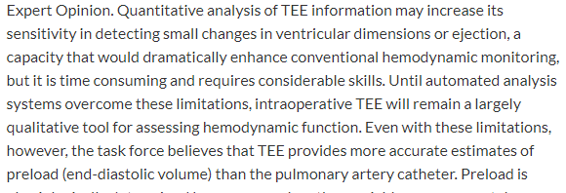

Slide 15
Noncardiac Surgery
Venous air embolism and patent foramen ovale in neurosurgery
Pericardial effusion and compression of the cardiac chambers in liver transplantation
Intracardiac emboli and patent foramen ovale,mitral regurgitation, left ventricular hypertrophy, and left ventricular outflow tract obstruction in orthopedic surgery
Left ventricular segmental wall motion abnormalities, aortic lesions and atrial tumors in vascular surgery
Atrial septal defect, myocardial ischemia, hypovolemia, pericardial tamponade, thromboembolic events , pericardial effusion, tamponade, and intrapulmonary emboli in other major surgery (i.e., lung, renal, abdominal, and head/neck/chest wall surgeries).
Anesthesiology, V 112 • No 5 • May 2010

Slide 16
Noncardiac Surgery
Recommendations for noncardiac surgery: TEE may be used when the nature of the planned surgery or the patient’s known or suspected cardiovascular pathology might result in severe hemodynamic, pulmonary, or neurologic compromise. If equipment and expertise are available, TEE should be used when unexplained life-threatening circulatory instability persists despite corrective therapy
Anesthesiology, V 112 • No 5 • May 2010

Slide 18
Basic Practice Requirement
Basic practitioner should be able to diagnose markedly abnormal ventricular filling or function, extensive myocardial ischemia or infarction, large air embolism, severe valvular dysfunction, large cardiac masses or thrombi, large pericardial effusions and major lesion of the great vessels
JASE, 2013; 26: 443-456

Slide 19
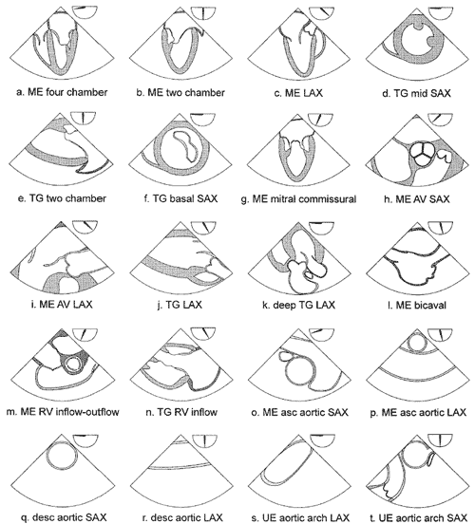
Examination

Slide 20
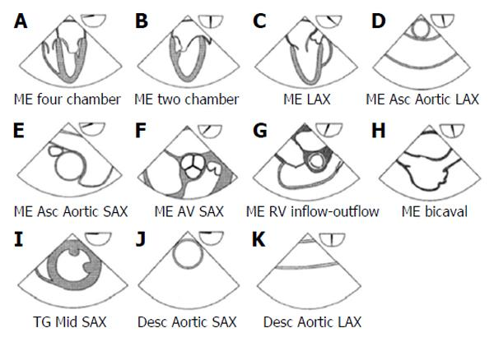

Slide 21
Contraindications
JASE, 2013; 26: 443-456

Slide 22
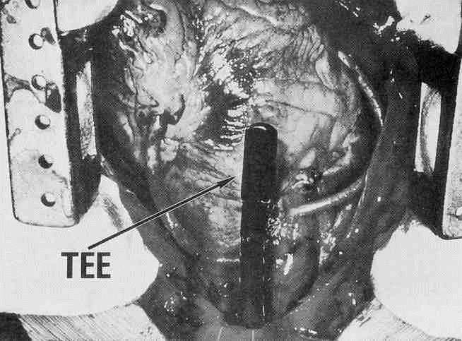
Complications…OOPS!!

Slide 23
Complications
JASE, 2013; 26: 443-456

Slide 24
What about Liver Transplant?
Multiple retrospective studies demonstrate:
Incidence major bleeding complications LOW (0.02-1%) Burger-Klepp et al. Transplantation 2012;94:192-96.
Risks NOT higher in MELD 25 or higher pts Myo Bui et al. JCVA 2015;29:594-97.

Slide 25
Basic (TEE) Questions
Is The Heart Full??
How is the Contractility )?
Is there any major/new valve abnormality?

Slide 26
Liver Transplant
Pre-Anhepatic
Anhepatic
Post-Anhepatic

Slide 27
Pre-Anhepatic

Slide 28
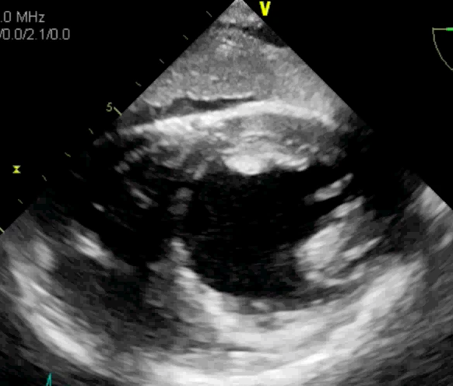
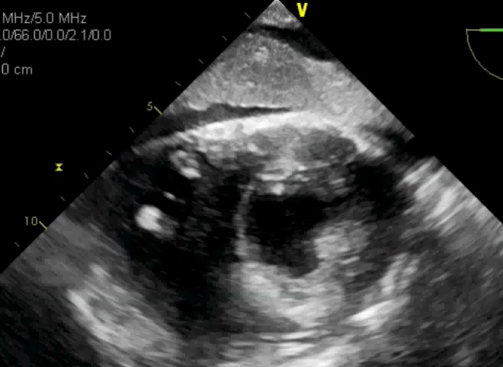
LV Volume
LV End Diastolic Diameter (Normal LVEDD ~5cm)
LV End Systolic Diameter
LVEDD | LVESD | Diagnosis
Decreased | Decreased | Hypovolemia
Unchanged | Decreased | Vasoplegia
Unchanged or Increased | Increased | Myocardial dysfunction
Notes:
Status of LV volume can be assessed using the LVEDD. Volume status can be assessed throughout a liver transplant by trending the LVEDD.
These are measurements made in TG mid-papillary SAX view.
Changes in both LVEDD and LVESD can help to distinguish between different scenarios: hypovolemia, myocardial dysfunction, vasoplegia.
LV Volume Estimate with LV Diastolic Diameter (LVEDD) Normal LVEDD ~5cm Monitor for changes from baseline exam ↓ LVEDD ↓LVESD ↓Volume ⇔LVEDD ↓LVESD ↓Vascular tone ↑/⇔LVEDD ↑LVESD ↓Myocardial function

Slide 29
LV Volume
LV End Diastolic Diameter (Normal LVEDD ~5cm)
LV End Systolic Diameter
LVEDD | LVESD | Diagnosis
Decreased | Decreased | Hypovolemia
Unchanged | Decreased | Vasoplegia
Unchanged or Increased | Increased | Myocardial dysfunction
Notes:
Status of LV volume can be assessed using the LVEDD. Volume status can be assessed throughout a liver transplant by trending the LVEDD.
These are measurements made in TG mid-papillary SAX view.
Changes in both LVEDD and LVESD can help to distinguish between different scenarios: hypovolemia, myocardial dysfunction, vasoplegia.
LV Volume Estimate with LV Diastolic Diameter (LVEDD) Normal LVEDD ~5cm Monitor for changes from baseline exam ↓ LVEDD ↓LVESD ↓Volume ⇔LVEDD ↓LVESD ↓Vascular tone ↑/⇔LVEDD ↑LVESD ↓Myocardial function

Slide 30
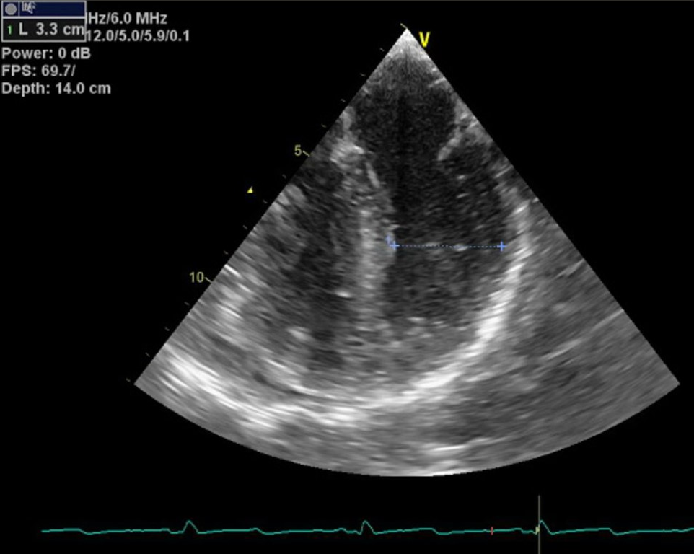
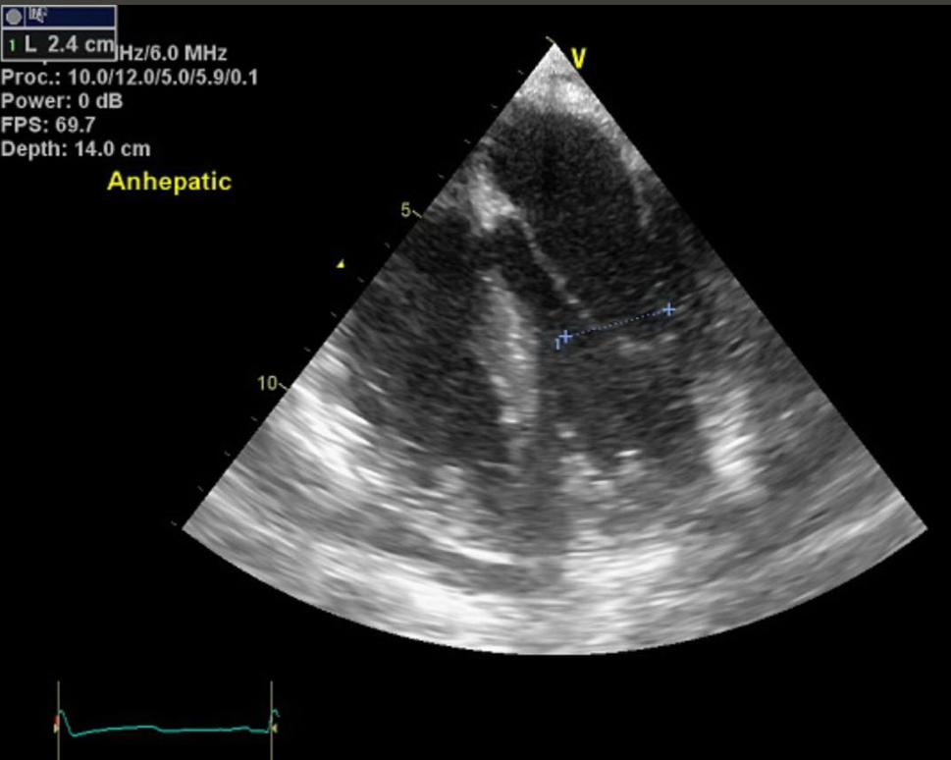
Assessment Hypovolemia: LV Volume
Baseline
Anhepatic
EDD 3.3 cm
ESD 2.4 cm
LVEDD | LVESD | Diagnosis
Decreased | Decreased | Hypovolemia
Unchanged | Decreased | Vasoplegia
Unchanged or Increased | Increased | Myocardial dysfunction
Notes:
It can sometimes be challenging to obtain TG SAX views during dissection when stomach is retracted. However, LVEDD can still be measured in
An example of comparing LVEDD from baseline measurement to anhepatic phase when IVC is clamped with less venous return to the heart. Demonstrates change in LVEDD during a period of hypovolemia.

Slide 31
Anhepatic

Slide 32
Left Ventricular Outflow Tract (LVOT)
New LVOT obstruction may suggest HYPOVOLEMIA
Notes:
-Asymmetric septal hypertrophy (septal bulge) may predispose pt to LVOT obstruction in setting of hypovolemia OR tachycardia
SIGNS
New color turbulence in LVOT
Comparison laminar vs turbulent flow
Treat new obstruction with volume & slower heart rate
- NOT inotropes

Slide 33
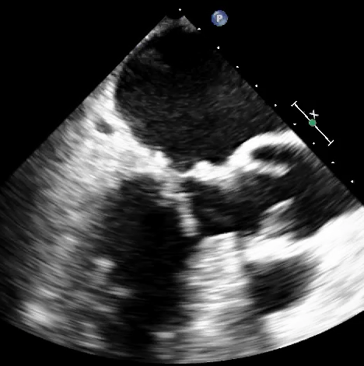
Systolic Anterior Motion (SAM)
New SAM may suggest HYPOVOLEMIA
Notes:
-Asymmetric septal hypertrophy (septal bulge) may predispose pt to LVOT obstruction in setting of hypovolemia OR tachycardia
SIGNS
New color turbulence in LVOT
New systolic anterior motion of the mitral valve in LVOT
Treat new obstruction with volume & slower heart rate
- NOT inotropes

Slide 34
Post-Anhepatic

Slide 36
LV Dysfunction
Global Dysfunction
Regional Dysfunction
RCA
Cx
LAD
Notes:
During reperfusion phase, sudden changes in hemodynamics (acute hypotension) may cause transient changes in global LV dysfunction.
Decreases in systolic function or contraction seen by less thickening of the myocardium.
Regional dysfunction may occur in patients with coronary artery disease. Could be baseline or occur during case with hypotension or coronary thrombotic event.
LV Function New wall motion abnormalities: ↓Myocardial function Normal EF 55-65% Fractional Area Change (FAC) is similar to EF in symmetric LV FAC = [(LVEDA – LVESA)/LVEDA] x 100

Slide 37
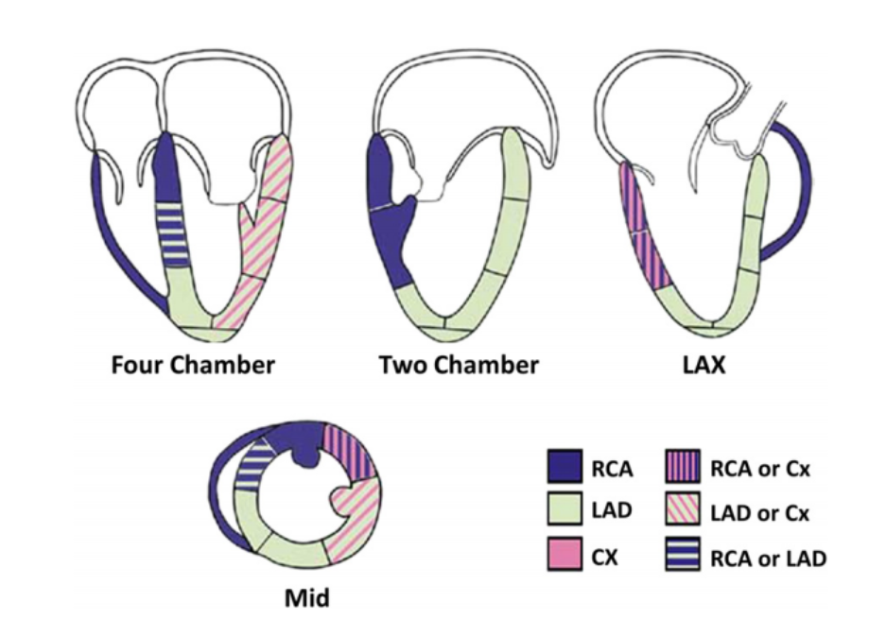

Slide 38
RV Dysfunction
Evaluate
RV Volume
RV Function
Septum
Tricuspid Valve
Thromboembolus
Views
ME 4C
ME RV Inflow-Outflow
ME Asc Aortic SAX

Slide 39
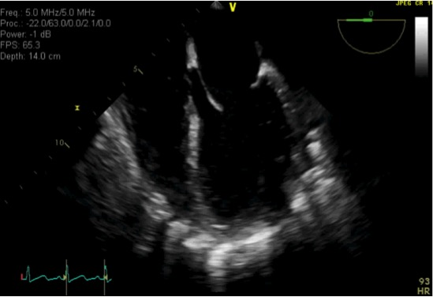
RV Dysfunction
Interatrial & Ventricular Septum Diastolic leftward shift suggests RV volume overload
Systolic leftward shift suggests RV pressure overload

Slide 40
RV Dysfunction
Distension
Decreased contractility
New or worsening tricuspid regurgitation
Notes:
RV dysfunction
**Important to watch for this during reperfusion with return of preload and possible thromboemboli

Slide 41
Thromboembolus
Notes:
Thromboembolic events may cause RV dysfunction.
Liver patients hypercoagulable and may be pre-disposed to thrombotic events.
TEE can diagnosed intraoperative thrombotic events that may change course of operation.

Slide 42
RV Dysfunction

Slide 43
Summary
TEE usage in liver transplant is increasing
TEE can be performed safely in liver patients
TEE can provide valuable information during the different phases of OLT
Notes:
TEE usage is increasing as seen by survey
TEE can be performed safely with minimal risk (no greater than routine periop TEE for other circumstances) – LV/RV volume and function, presence of thromboembolus
Further training and education of mostly non-cardiac trained providers to incorporate use of TEE in practice
- This will require developing pathway that is feasible including certification. Currently only BASIC available, perhaps a change in the future
- As support and evidence for TEE grows, the transplant and echo communities are working on creating guidelines and/or recommendations that should help with this process

Slide 44
Thank you!

Slide 45
An absolute contraindication for the use of TEE is :
Question 1
Esophageal Varices
Esophageal Stricture
Hiatal Hernia
Spinal Stenosis
Esophageal Perforation

Slide 46
Question 1
An absolute contraindication for the use of TEE is :
Esophageal Varices
Esophageal Stricture
Hiatal Hernia
Spinal Stenosis
Esophageal Perforation

Slide 47
During the pre-anhepatic phase what is the most likely LV scenario among the follows?
Question 2
LVEDD LVESD
LVEDD LVESD
LVEDD LVESD
LVEDD LVESD
LVEDD LVESD

Slide 48
Question 2
During the pre-anhepatic phase what is the most likely LV scenario among the follows?
LVEDD LVESD
LVEDD LVESD
LVEDD LVESD
LVEDD LVESD
LVEDD LVESD

Slide 49
During the anhepatic phase your patient become suddenly hypotensive and tachycardic. TEE shows small chambers and the images below when you apply color doppler. What is the most appropriate treatment?
Question 3
Epinephrine
Fluid Bolus + Phenylephrine
Fluid bolus + Ephedrine
Norepinephrine
Dobutamine

Slide 50
Question 3
During the anhepatic phase your patient become suddenly hypotensive and tachycardic. TEE shows small chambers and the images below when you apply color doppler. What is the most appropriate treatment?
Epinephrine
Fluid Bolus + Phenylephrine
Fluid bolus + Ephedrine
Norepinephrine
Dobutamine

Slide 51
Question 4
In the post reperfusion phase what can be the cause for the change from A to B?
A
B

Slide 52
Question 4
A 500 ml bolus
Ischemia
PE
MV ruptured chordae
All of the above

Slide 53
Question 4
A 500 ml bolus
Ischemia
PE
MV ruptured chordae
All of the above

Slide 54
Question 5
After reperfusion BP drops. Which coronary artery is mostly affected by CAD in this patient?

Slide 55
Question 5
RCA
LAD
Cx
L Main
All of the above

Slide 56
Question 5
RCA
LAD
Cx
L Main
All of the above

Slide 61
TEE Contraindications
Table adapted from JASE 2010;23:1115-27. JASE 2013;26:921-64. Anesthesiology 2010:112:1-13 .
Notes:
Listed are the contraindications to TEE adapted from perioperative TEE guidelines (from JASE and Anesthesiology).
Highlighted boxes indicate areas of risk that may be higher in the liver transplant population.
One area that is likely of highest concern in the liver transplant population is GI bleeding.

