Slide 1
PULMONARY HYPERTENSION
IN LUNG TRANSPLANTATION
kATHIRVEL SUBRAMANIAM MD MPH
ASSOCIATE PROFESSOR OF ANESTHESIOLOGY
UNIVERSITY OF PITTSBURGH, PITTSBURGH PA USA
UNIVERSITY

Slide 2
Before we begin…

Slide 3
Case history
52 years old woman with sarcoidosis, end stage lung disease (6 lit/min), pulmonary hypertension presented for double lung transplantation
ABG : pH 7.47, P_{a}CO₂ 43 mmHg, P_{a}O₂ 66 mmHg, bicarbonate 31 mEq/L and SaO2 92%
FEV1 23% predicted/FVC 34% predicted /FEV1/FVC 0.51

Slide 4
PREOP TTE
Severely dilated and hypertrophied RV
Interventricular septal flattening and paradoxical septal motion
Moderate TR & Estimated PASP was 91 mmHg.
LVEF -55-60% and grade 1 diastolic dysfunction.

Slide 5
CARDIAC CATH
PAP 71/29/47 (systolic/diastolic/mean) mmHg
CVP 13 mmHg ; PCWP 17 mmHg
Calculated TPG (Mean PAP-PCWP) = 30 mmHg
Fick cardiac index was 4.07 L/min/m²

Slide 6
ANESTHESIA INDUCTION
She presented to the operating room with a BP 108/73 mmHg; HR 110/minute, and SaO2 of 99% on 6 liters/minute of nasal cannula oxygen.
Oral and IV pulmonary vasodilators continued (Sildenafil, IV Milrinone)
No premedication given

Slide 7
Induction of anesthesia
Invasive Radial Arterial Line was placed
Preoxygenation, Midazolam 10 mg, Fentanyl 150 ug and Rocuronium 100 mg
35 DLT placed without difficulty
Vitals immediately before endotracheal intubation; HR 114/minute, BP 142/62 mmHg and SaO₂ 100%.

Slide 8
Events
Three minutes after induction and one minute following intubation, the patient SBP was 68 mmHg
Cardiac arrest with pulseless electrical activity.
CPR started/10 mg of EPI, 60 units of vasopressin, 64 mcg of NE, 2 g CaCl2 and NaHCo3 50 mEq.
SBP remained between 44-74 mmHg) in spite of resuscitation medications.

Slide 9
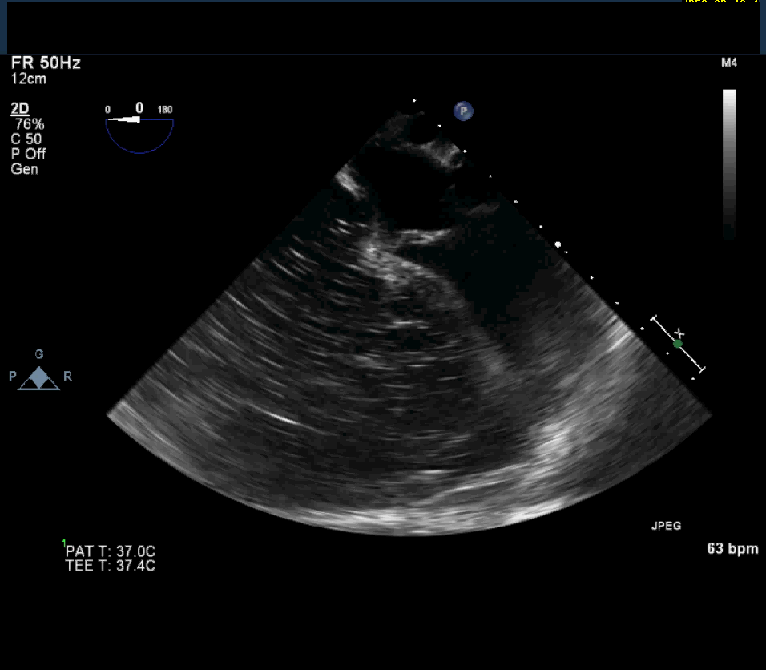

Slide 10
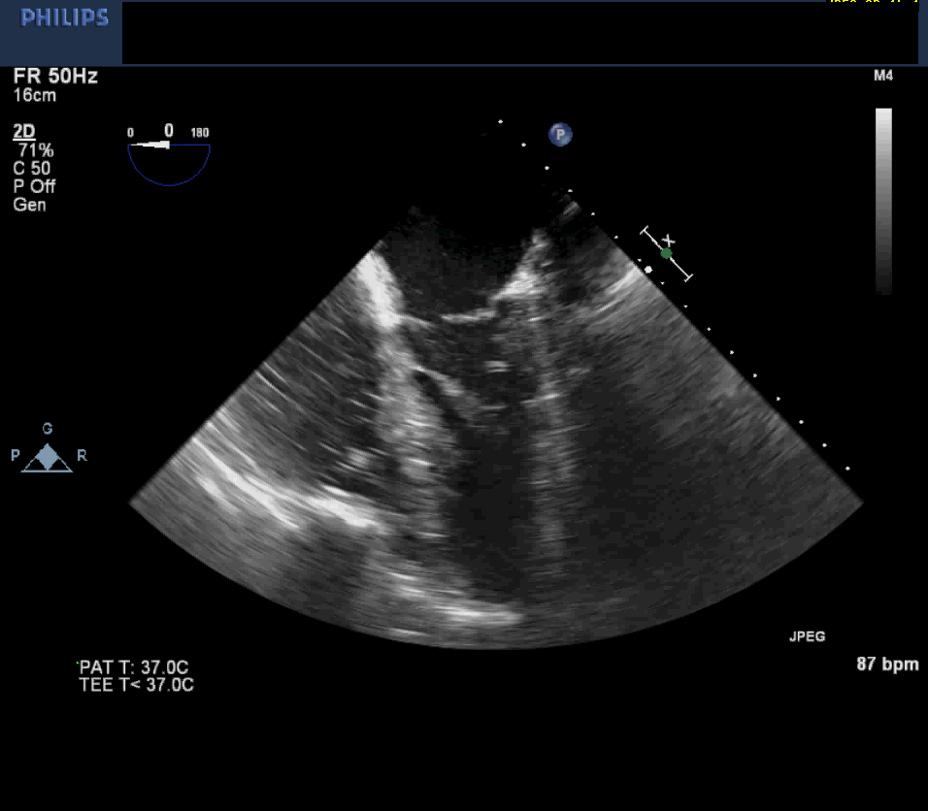

Slide 11
Top 10 safety guidelines

Slide 12
No 1 Preoperative red flags
History of syncope, NYHA 3 or 4, low 6 minute walk test
Signs of venous congestion (ascites, edema, JVD)
Severe PAH, RV Dysfunction, Severe TR on preoperative echo and cath

Slide 13
Red flags
N=68 Lung transplant patients
Hypotension (less than 40% from baseline or < 60 mmHg)
Risk factors
Toshiyuki Mizota, MD,* Shino Matsukawa, MD,* Hiroshi Fukagawa, MD etal. Preoperative Hypercapnia as a Predictor of Hypotension During Anesthetic Induction in Lung Transplant Recipients Journal of Cardiothoracic and Vascular Anesthesia, Vol 29, No 4 (August), 2015: pp 967–971

Slide 14
Multivariable risk factors for hypotension after induction
 | ODDS RATIO | P-VALUE
Age | 1.04 (1.00-1.08) | 0.037
PaCO2 | 12.54 (3.10-66.66) | 0.001
Pulmonary hypertension (SPAP >40 mmHg) | 3.97 (1.24-14.17) | 0.025

Slide 15
No 2; Appreciate the need for mechanical support
Hemodynamic collapse not responding to conventional resuscitation
Mechanical circulatory support ( VA ECMO) support may be needed
Clinicians with expertise should be available (ICU Team, Cardiac surgeon, Perfusionist)

Slide 16
Red flags for the need of MCS
Severe hypoxemia (SaO2 < 80%) in spite of receiving high oxygen flow through non-rebreathing mask or non-invasive ventilation with higher FIO2
Severe Hypercapnia (> 70 mmHg)
Low systolic BP (< 70 mmHg) along with high CVP (> 20 mmHg)

Slide 17
No 3; Managing RV Preload
Decrease preload
PPV, Venodilation with induction
Increase preload
Inadvertent fluids, Trendelenburg position for line placement

Slide 18
RV Preload
No gold standard monitor
SVV/PVV- Does not work in patients with RV dysfunction
IVC Collapsibility index is not reliable in RV dysfunction
Passive leg raising test – Can be dangerous in RV dysfunction and not recommended

Slide 19
RV Preload
Clinical judgement
Graded fluid challenge
CVP Monitoring is still useful
TTE/TEE Monitor of RV Distension/Dysfunction

Slide 20
No 4; Systemic blood pressure
Most important in preventing cardiovascular instability
Systolic BP 20-30 mmHg above estimated systolic PAP (by TTE or PA cath)
Maintaining RV perfusion is vital ; Only diastolic flow in pulmonary HTN

Slide 21
No 5; Pulmonary vascular resistance
RV Not a smaller left ventricle
Volume pump
Thin walled

Slide 22
Ventricles As Pumps
100
LV
pressure
LV “Pressure” Pump
RV
RV “Volume” Pump
20
volume
Notes:
It pumps the same cardiac volume with roughly 25% of the stroke work of the left ventricle…

Slide 23
Right Ventricle
Job Description
Provide Left Ventricle Diastolic Volume
Permit End-Organ
Venous DRainage

Slide 24
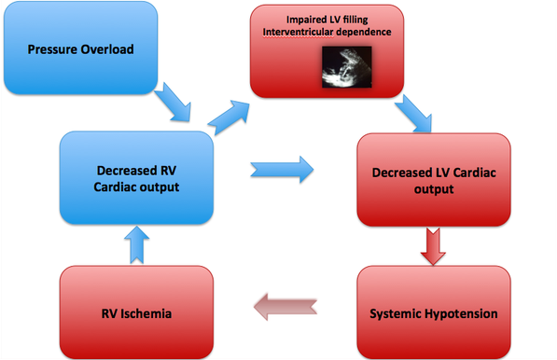

Slide 25
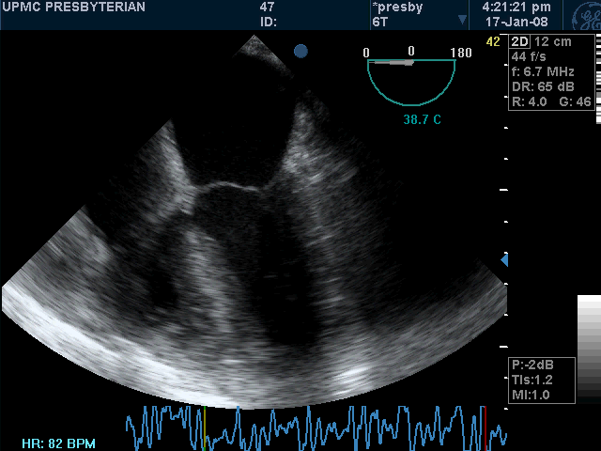
Ventricular interdependence

Slide 26
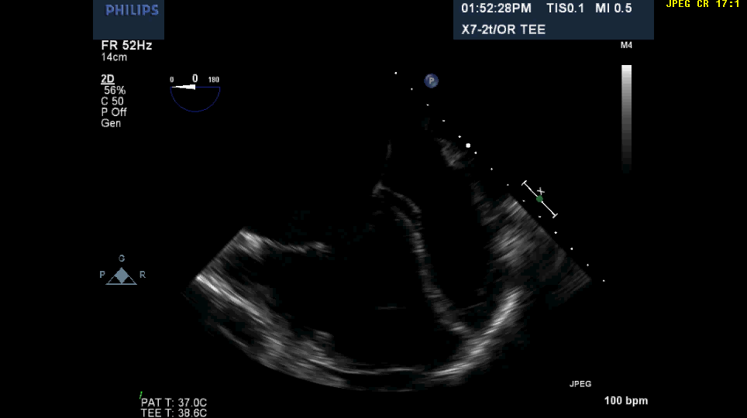
Ventricular interdependence

Slide 27
Solutions for decreasing PVR
Avoid
Hypoxemia
Hypercarbia
Acidosis
Hypothermia
Hypervolemia
Light Anesthesia
Variation In Lung Volumes(atelectasis,overdistension)

Slide 28
Pharmacologic management
Avoid intravenous pulmonary vasodilators (NTG, NTP, Nicardipine, PGs)
Inhaled pulmonary vasodilators preferred (Inhaled Epoprostenol, Inhaled Iloprost, Inhaled Milrinone, Inhaled NTG, Inhaled Nitric oxide)

Slide 29
Inhaled NO

Slide 30
Inhaled Iloprost

Slide 31
Inhaled Prostaglandins

Slide 32
Simple system

Slide 33
Hemodynamics
Systemic BP
Pulmonary vascular resistance

Slide 34
No 6; Induction drug of choice

Slide 35
Induction drug of choice
EPINEPHRINE

Slide 36
Inotropic drugs during induction
EPINEPHRINE
MAINTAINS RV CONTRACTILITY
IMPROVES SYSTEMIC BP

Slide 37
Milrinone
Improves RV Afterload
Continue if the patient is already on preoperative Milrinone
Inhaled Milrinone preferred because IV Milrinone causes systemic hypotension

Slide 38
No 7; Anesthesia Induction Drugs Preferred
Etomidate
Ketamine
Inhalational induction

Slide 39
Caution!!!
Propofol
Thiopental
Midazolam + Narcotic combination

Slide 40
No 8; Monitors
ASA Monitors
Invasive BP A must before induction of anesthesia
PA Catheter
Central venous catheter

Slide 41
Monitors
Point of care ultrasound (RV Function monitoring during induction & PASP measurement before induction)
TEE - Probe insertion immediately after endotracheal intubation

Slide 42
PASP Measurement

Slide 43
No 9; Ventilation
Despite all efforts mentioned above, PHT patients can develop severe hypotension with PPV
Low tidal volume (6 ml/kg)
Low peak airway pressures (>25 mmHg)
100% Oxygen
Optimize expiratory time to avoid auto PEEP
Adjust RR to maintain CO2 to around 45-50 mmHg

Slide 44
No 10; Personnel
Experienced anesthesiologist
Anesthesiologist with understanding of pulmonary circulation and RV
Anesthesiologist with Echocardiography skills

Slide 45
Conclusions
Mild PAH- Keep calm and relaxed, do the right thing as any other anesthetics
Moderate PAH- Be cautious
Severe PAH- Be serious

