Slide 1
Basic Evaluation of LV Function
Dr. Justin Tawil
Cardiothoracic Anesthesiology and Critical Care Medicine
Medical College of Wisconsin
Milwaukee, WI

Slide 2
Disclosure
Nothing to disclose
All images were taken from my patients
All cartoon images come from Reeves Consensus on Basic PTE

Slide 3
Pre Test 1: Which coronary is occluded?
1:LAD
2:Cx
3:Left Main
4:RCA

Slide 4
Pre Test 2:What is this patient’s visually estimated left ventricular function?
1:>70%
2:55-69%
3:35-55%
4:<35%

Slide 5
Pre Test 3:What is this patient’s visually estimated left ventricular function?
1:>70%
2:55-69%
3:35-55%
4:<35%

Slide 6
Pre Test 4: What Basic TEE views are helpful for Visually estimating EF?
1: TG LV midpap short axis
2: ME four-chamber
3: ME two-chamber
4: ME long-axis
5: All of the above

Slide 7
Pre Test 5: Which of these images has better systolic function?
1: 2:

Slide 8
Summary
LV function
17 segment model
Coronary distributions
Qualitative RWMA and Systolic Function
Quantitative measurement of Ejection Fraction (Simpson’s Method)
Review the pretest questions

Slide 9
Normal – Not normal – Really bad
Wall Motion
1 – normal (normal)
2 – hypokinetic (not normal)
3 – akinetic (really bad)
Global systolic function
Normal - EF > 55%
Mild to Moderate Dysfunction
Not Normal
EF < 55%
Severe Dysfunction
Really bad
EF < 35%

Slide 10
17 Segment Model
Anterior
Don’t memorize the numbers
4 Levels :
Base(6): Ant, Ant-Sept, Inf-Sept, Inf, Inf-Lat, Ant-Lat
Mid(6): Ant, Ant-Sept, Inf-Sept, Inf, Inf-Lat, Ant-Lat
Apical(4): Anterior, Septal, Inferior, Lateral
True Apex: Not well seen on TEE
BA 1
MA 7
BAS 2
AA 13
BAL 6
MAS 8
MAL 12
Septal
AS 14
Apex 17
AL 16
Lateral
MIS 9
MAS 15
MIL 11
BIS 3
BIL 5
MI 10
BI 4
Inferior

Slide 11
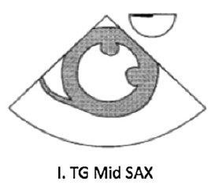
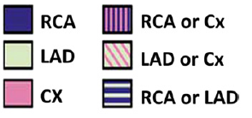
TG Mid SAX
Best view for differentiating RWMA due to ischemia
Posteromedial pap to the septum is inferior territory
The lateral wall is circumflex
The anteriolateral pap often divides Cx from LAD
The anterior wall and anterior septum are LAD territory
The ME4C view MAY also show all three, but…
Imaging plane varies with the degree of omniplane, retroflex and anatomic factors.
Blood flow from the LAD vs Cx harder to differentiate in the ME4C

Slide 12
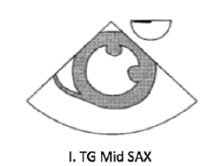
Normal – Not normal – Really bad

Slide 13
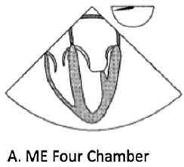
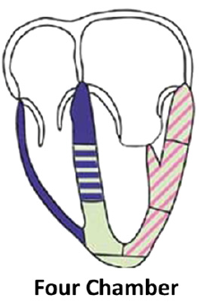
ME4C (omniplane ~20)
Remember we’re not quite at 0 degrees
Inferoseptal wall:
Basal Segment is RCA
Mid Segment can be RCA or LAD
Apical Segment and Apex are LAD
Anterolateral wall:
LAD or Cx
Notes:
Septum : Basal(RCA) Mid(LAD or RCA) Apical (LAD)
Lateral wall base, mid, apex – LAD or CX

Slide 14
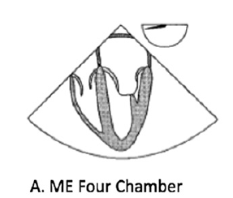
Normal – Not normal – Really bad

Slide 15
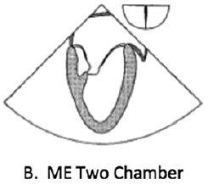
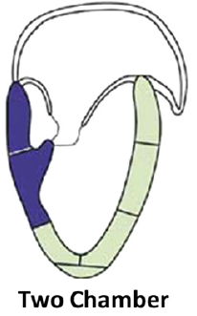
ME2C (omniplane ~90)
True Anterior-Posterior
Anterior Wall, Apex, and Apical Inferior segments: LAD
Inferior Basal & Mid segments: RCA
Clinical Correlation:
Ruptured pap is usually the posteromedial (Inferior MI)
No collateral perfusion
The Anterolateral has collateral flow from both LAD/Cx
Notes:
Anterior: basal, mid, apical
Inferior: basal mid apical

Slide 16
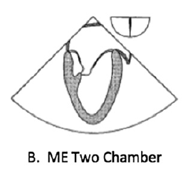
Normal – Not normal – Really bad

Slide 17
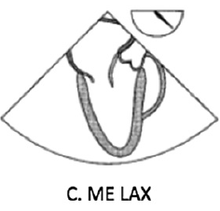
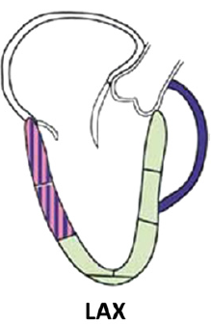
ME LAX (omniplane ~140)
Inferiolateral wall
Segment between papillary muscles
Boundary zone of the RCA and Cx
Anteroseptal wall
LAD territory: base, through mid, past apex into the apical IL segment

Slide 18
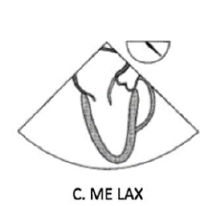
Normal – Not normal – Really bad

Slide 19
Qualitative
Your brain is a powerful computer and can integrate several slices to yield an EF
Try not to jump to assigning the EF until you have completed your exam
If you commit too early, you may be biased against future information
Beginners often confuse tachycardia with good systolic function
Conversely it is easy to confuse bradycardia with poor function
“It just doesn’t look snappy”
Often objective measures disagree and your overall impression is the best tie breaker

Slide 20
Tachy/brady

Slide 21
Objective Measures
Fractional Change (Diastolic-Systolic)/Diastolic
Fractional Shortening (linear model)
Fractional Area Change (area model)
Ejection Fraction (volume model)
Simpson’s Method
3D
Mitral Valve E-Point Septal Separation
Strain Mapping
Speckle tracking
dP/dt (change in pressure over time)

Slide 22
Objective measures
Pick one or two that you will understand, remember and be able to perform in 6 months
Calibrate yourself
Train your eyeballs
Check your intuition
Quantitative methods are not required at the basic level but can be very helpful

Slide 23
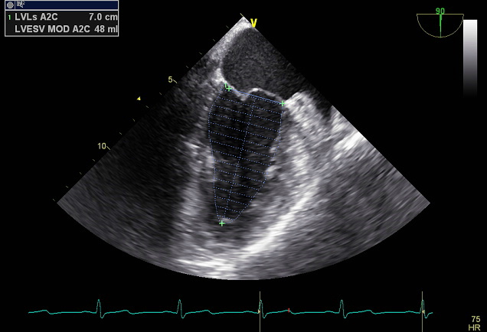
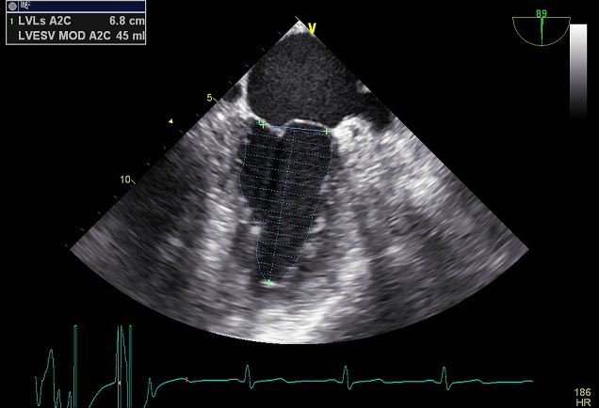
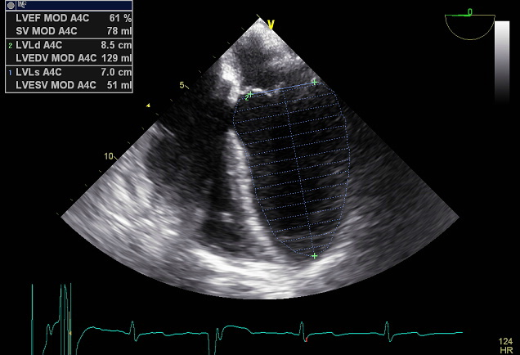
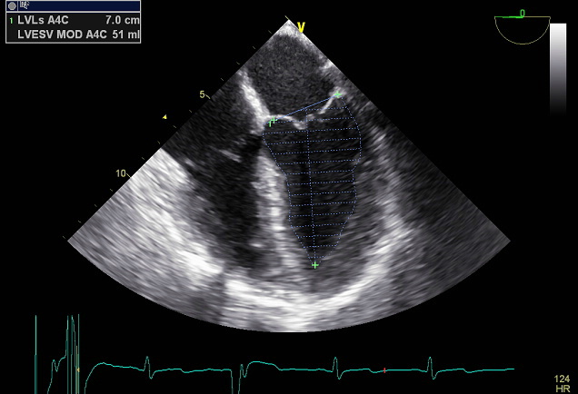
Modified Simpson’s Method of Disks

Slide 24
Modified Simpson’s Method of Disks
ME4C & ME2C views are orthogonal
Measure LV size during diastole and systole (change in area)
Combine the two changes in area for reliable estimation of EF
Strengths
Few geometric assumptions
Captures the major coronary territories in two complimentary planes
Weaknesses
Does miss posterolateral & anteroseptal regions
Image quality is important
Need clear endocardial boarders
Foreshortening causes errors
Arrhythmia
Dyssynchrony
Time consuming

Slide 25
Post Test 1: Which coronary artery is occluded?
LAD
Cx
Left Main
RCA

Slide 26
Post Test 1: Which coronary is occluded?
LAD
Cx
Left Main
RCA
Explanation: Here the inferior wall is affected. The RCA accounts for RWMA in the inferior wall. The septasl/lateral/anterior walls are hypokinetic but functioning.

Slide 27
Post Test 2:What is this patient’s visually estimated left ventricular function?
>70%
55-69%
35-55%
<35%

Slide 28
Post Test 2:What is this patient’s visually estimated left ventricular function?
>70%
55-69%
35-55%
<35%
Explanation: The TGSAX shows severe global hypokinesis and akinesis of the inferior wall. The EF here is ~20%.

Slide 29
Post Test 3:What is this patient’s visually estimated left ventricular function?
>70%
2:55-69%
35-55%
4:<35%

Slide 30
Post Test 3:What is this patient’s visually estimated left ventricular function?
>70%
55-69%
35-55%
<35%
Explanation: This patient shows a hyperdynamic LV with cavity obliteration (complete emptying of the LV).

Slide 31
Post Test 4: What Basic TEE views are helpful for Visually estimating EF?
TG LV midpap short axis
ME four-chamber
ME two-chamber
ME long-axis
All of the above

Slide 32
Post Test 4: What Basic TEE views are helpful for Visually estimating EF?
TG LV midpap short axis
ME four-chamber
ME two-chamber
ME long-axis
All of the above
Explanation: All of these views should be taken in to account when estimating LVEF.

Slide 33
Post Test 5: Which of these images has better systolic function?

Slide 34
Post Test 5: Which of these images has better systolic function?
Explnanation:
1: EF ~ 20 %. Tachycardia can make dyssynchrony harder to spot and shadow/artifact motion is easier to confuse with actual contractility.
2: EF ~ 40%. Bradycardia doesn’t give the “snappy vigor” on first glance.
A.
B.

Slide 35
References
Reeves ST, et al. Expert Consensus Statement: Basic Perioperative Transesophageal Echocardiography Examination: A Consensus Statement of the American Society of Echocardiography and the Society of Cardiovascular Anesthesiologists J Am Soc Echocardiogr 2013;26:443-56.

Slide 36
Questions?

