Slide 1
CON: We Should Routinely Use TEE in Liver Transplants
Ryan Chadha MD
Mayo Clinic Florida
May 1, 2018

Slide 2
Why not use it?
(The old arguments)

Slide 3
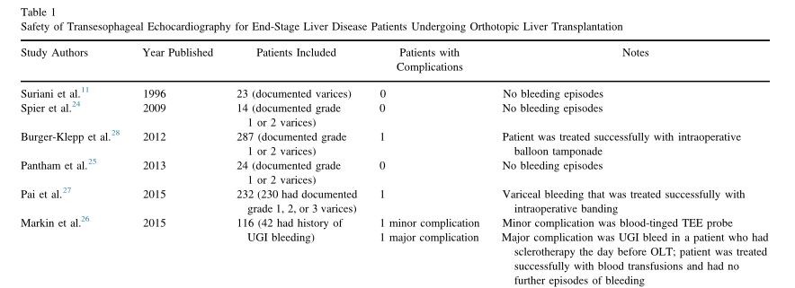
Safety Concerns?

Slide 4
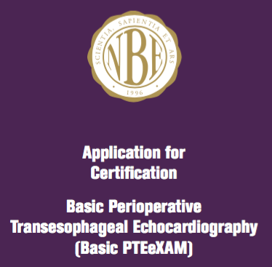
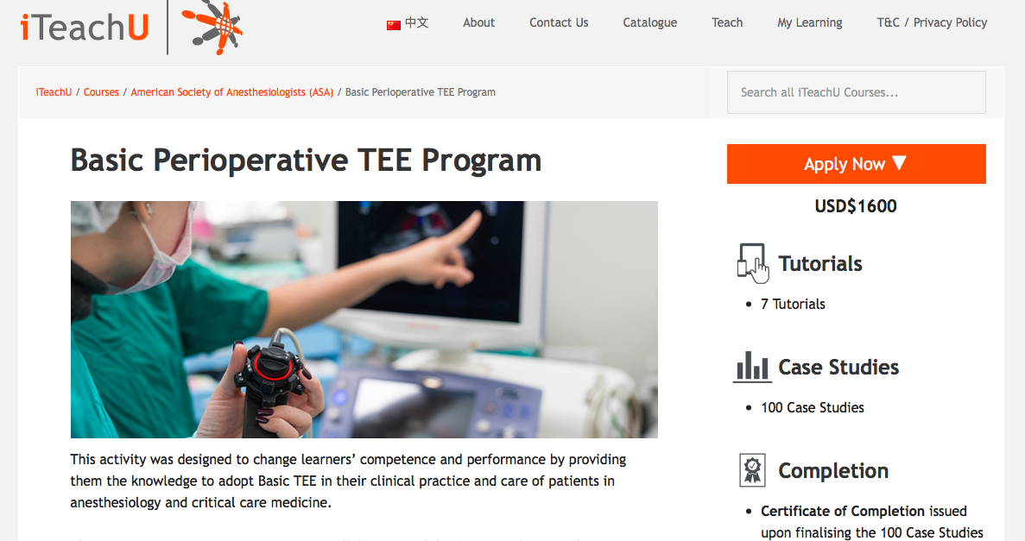
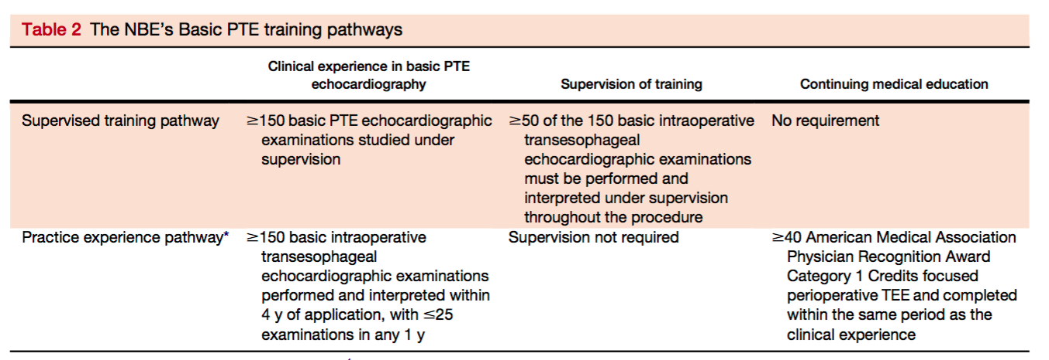
Training?

Slide 5
SO THEN WE SHOULD USE IT ROUTINEly?

Slide 6
Societal Recommendations
The 2010 Updated Practice Guidelines for Perioperative Transesophageal Echocardiography by ASA/SCA published survey results regarding TEE in OLT
53.7% of expert consultants (n = 55) and 46 % (n = 779) of ASA members agreed that TEE should be used as a routine monitor in OLT.
Asked consultants if these guidelines would change their practice in liver transplant, 0% (n = 14 total) answered yes.
2010: European Association of Echocardiography -> “TEE may be recommended for monitoring cardiac performance and evaluating cardiac chamber volume and performance”

Slide 7
Does TEE affect outcomes?
A significant portion of the literature regarding TEE in OLT is case report driven.
TEE has been successful in emergently identifying a number of pathologies intraoperatively including:
Biventricular failure, LVOTO, SAM, ICT, vascular occlusions, paradoxical air.

Slide 8
-100 patients done using the bi-caval technique.
-TEE performed by qualified anesthesiologist. (Fellowship trained)
-Identified abnormal TEE findings in the three phases of OLT (dissection, anhepatic phase, and reperfusion phase)
-Biventricular dysfunction and intracardiac thrombosis during only the reperfusion phase was found to be significantly associated with a major adverse cardiac event at 30 days and 1 year.
-So should we just insert TEE as needed during reperfusion if there are unexpected hemodynamic disturbances?

Slide 10
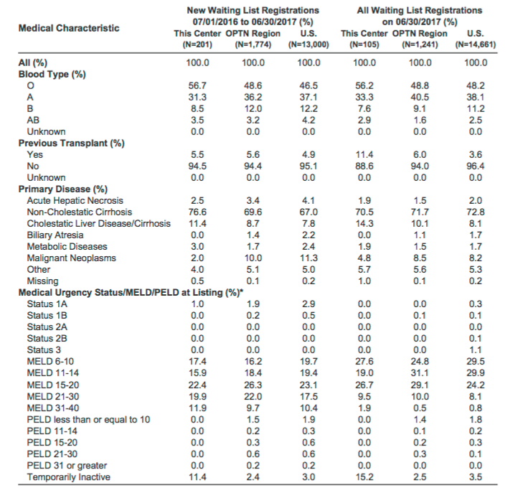

Slide 11
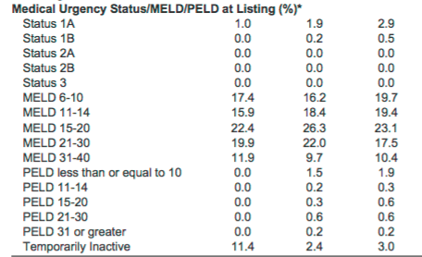

Slide 12
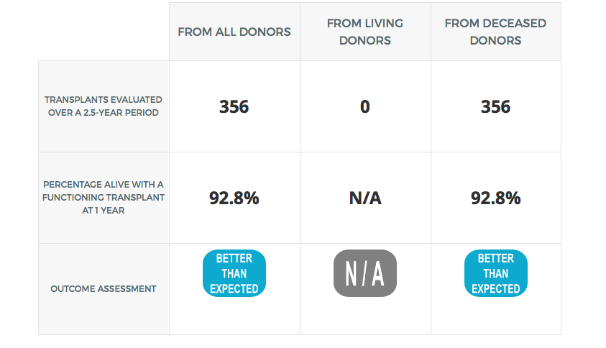
Intraoperative TEE Use: 15%

Slide 13
- Several views are hard to obtain like the transgastric view.
-”Single view” monitoring for RMWA and LVSF may not be available, requiring frequent probe manipulation
-Because TEE provides direct visualization of cardiac performance, contractility and volume status frequently are “eyeballed” rather than measured.
-TEE should be considered complementary to other monitoring devices.

Slide 14
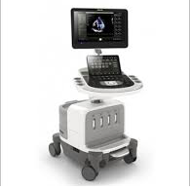
Cost?
EPIQ 7C Ultrasound System
$446,760, not including probe

Slide 15
OLT in the USA
As per UNOS database:
117 Adult liver transplant programs in the country.
30 did > 100 OLTs in 2017 (~50% of the total transplant in the USA).
35 did 50 – 100 OLTs in 2017.
52 did < 50 OLTs.

Slide 16
Is TEE alone the answer?
Or rather is it the TEE in the hands of an experienced operator as part of a dedicated liver transplant anesthesia team that can effect outcomes?
Routine use of TEE by a liver transplant anesthesiologist may have an impact in the future.

Slide 17
Summary
TEE is an extremely valuable monitor for the anesthesiologist in the liver transplantation procedure.
It is safe and is becoming easier to become competent in. All liver transplant anesthesiologists should attempt to attain PTE Basic certification.
In emergency situations of unexplained hypotension, hypoxemia, or arrhythmia, it should be inserted to help guide management. It should be readily available for all OLT cases.
Patients with known portopulmonary HTN, HOCM/IHSS, or valvular disease should be considered for intraoperative TEE.

Slide 18
Summary
Routine use during OLT is hard to support at this time.
It has a lack of proven mortality benefit. Further studies are needed.
Due to the nature of the liver transplant procedure, several views are difficult to acquire and there is some degree of subjectivity if actual measurements are not performed.
The cost is significant of TEE, which may be cost-prohibitive to smaller centers.

Slide 19
Thanks!
Questions? chadha.ryan@mayo.edu

