Slide 1
TRANSESOPHAGEAL ECHOCARDIOGRAPHY BASIC VIEWS, CONTRAINDICATIONS AND COMPLICATIONS
KATHIRVEL SUBRAMANIAM MD MPH
ASSOCIATE PROFESSOR OF ANESTHESIOLOGY
UNIVERSITY OF PITTSBURGH
PITTSBURGH PA, USA

Slide 2
Goals
Review the equipment
Review the safety considerations
Standard Basic TEE Examination views

Slide 3
SAFETY
Know your patient
Know your equipment

Slide 4
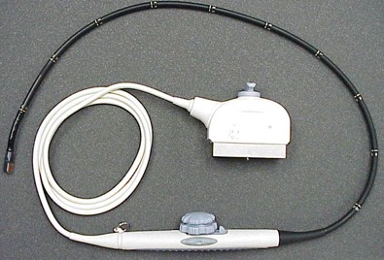
TEE PROBE
PROBE SHAFT
PROBE HANDLE
PLUG IN SOCKET
PROBE TIP

Slide 5
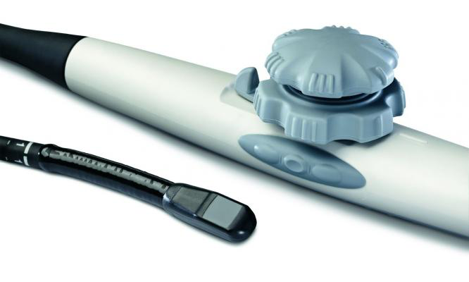
Probe manipulations
SMALL WHEEL
(LATERAL FLEXION)
LOCK
BIG WHEEL (ANTE/RETROFLEX)
CRYSTAL MANIPULATION

Slide 6
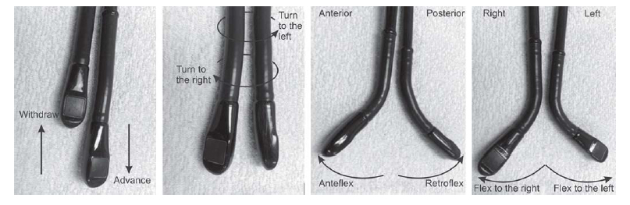
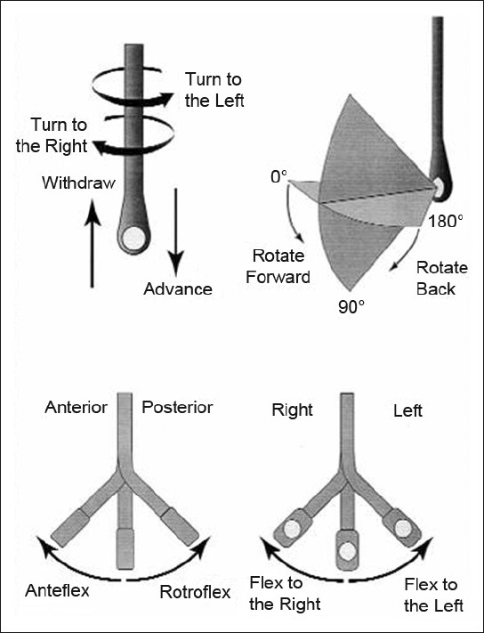
Probe manipulations

Slide 7
TEE IS SEMIINVASIVE!
Informed consent from the patient or next of kin
Consent need not be obtained during life threatening emergencies
NG tube can be left in place
Aspirate gastric contents
Check the position of NGT after removal of TEE probe
Review the indication for TEE
Look for contraindications for the procedure

Slide 8
Contraindications
Absolute
Relative
Active GI Bleeding
Recent history of GI bleeding
Recent esophageal or gastric surgery
Esophageal obstruction from tumor or stricture
Poor airway control
Zenker Diverticulum, Pharyngeal pouch
Severe Cervical spine disease or injury
Esophageal trauma, Facial trauma
Barret Esophagus
Hiatal Hernia
Esophageal varices, web
Radiation therapy
Previous bariatric surgery
Thoracic aortic aneurysm
Dysphagia
Coagulopathy

Slide 9
STANDARD TEE EXAMINATION
Basic TEE views only will be discussed
11 Views as recommended by American Society of Echocardiography/Society of Cardiovascular Anesthesiologists
Mid-esophageal, Trans-gastric and Aortic views

Slide 10
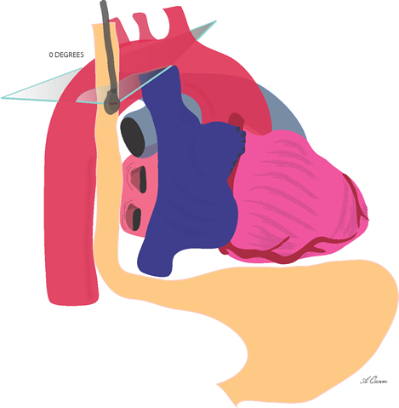
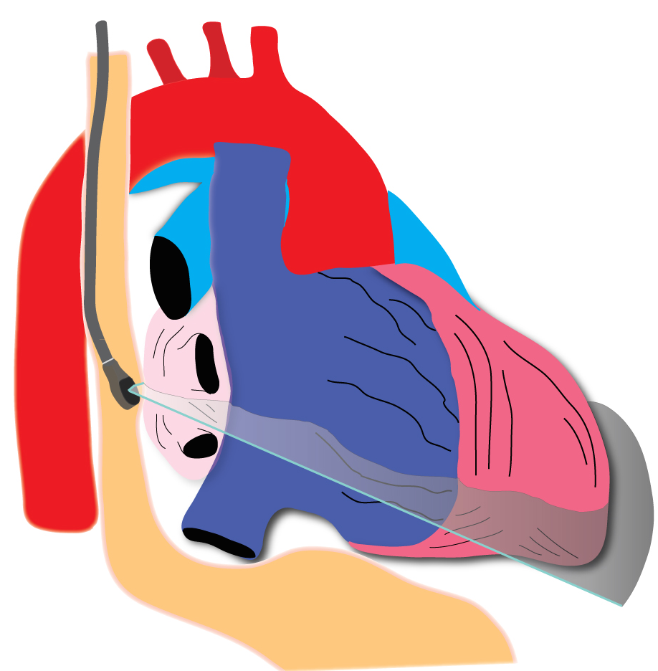
Upper Esophageal (25 cm) / Mid-Esophageal (35 CM)

Slide 11
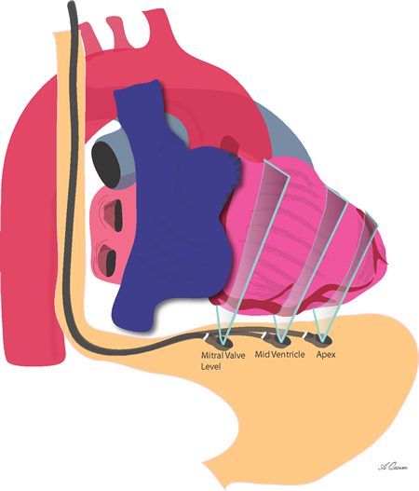
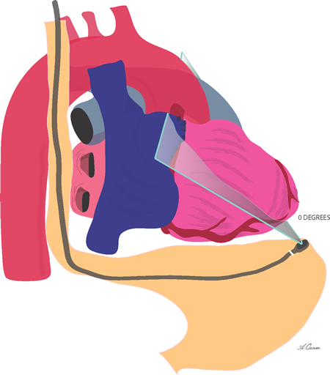
Trans-gastric (40 cm) / Deep Trans-gastric (50 cm)

Slide 12
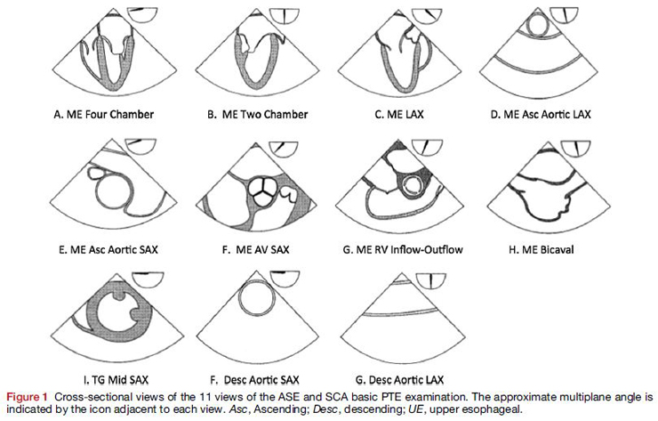
Standard basic TEE examination

Slide 13


Mid-esophageal 4 Chamber view
Depth 30-35cm
Center MV and LV in sector display
  clockwise or counterclockwise probe rotation
Adjust depth so LV apex is visible (Foreshortening of apex common with TEE)
Multiplane angle rotation to 10-20º

Slide 14
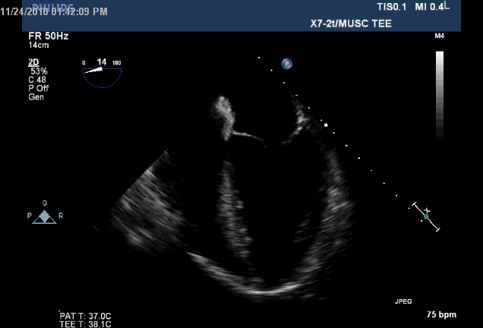
ME 4-chamber view Structures
IAS
LA
RA
AMVL
PMVL
TVPL
TVSL
RV
LV
IVS

Slide 15
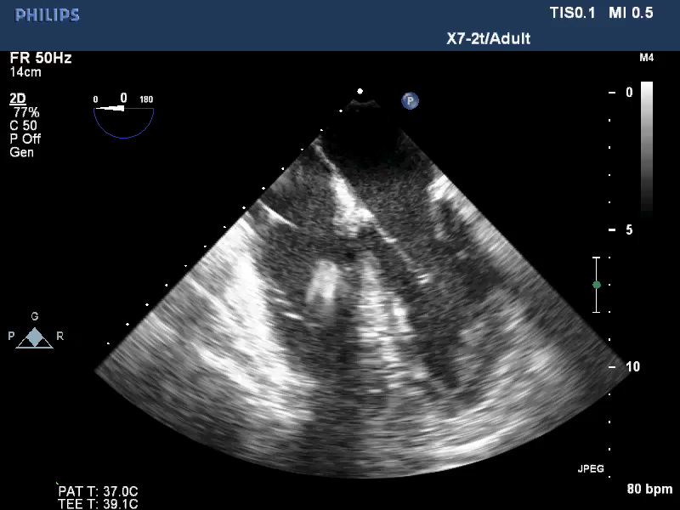
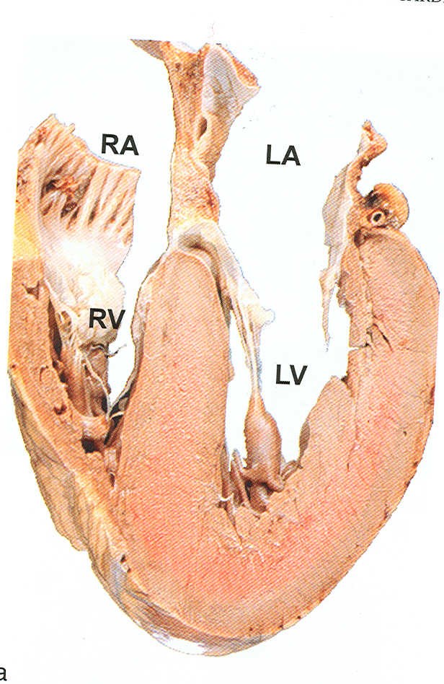
ME 4 Chamber view
INFERO
SEPTAL
AL WALL
APEX

Slide 16
ME 4 Chamber view Clinical utility
Global RV, LV function
Tricuspid Annular plane motion (RV Function)
Regional LV: Inferoseptal and Anterolateral walls
Color flow doppler over MV, TV, IAS to evaluate for pathology and shunt (Nyquist Limit 50-60 cm / sec)
Bowing of IAS, IVS indicates pressure differences

Slide 17
ME Two Chamber View
Rotate multiplane angle to 80 - 100º until RV disappears
Global/Regional LV function: Anterior and Inferior Walls
MV structure and function (add CFD)
Left atrial appendage evaluation for clots

Slide 18
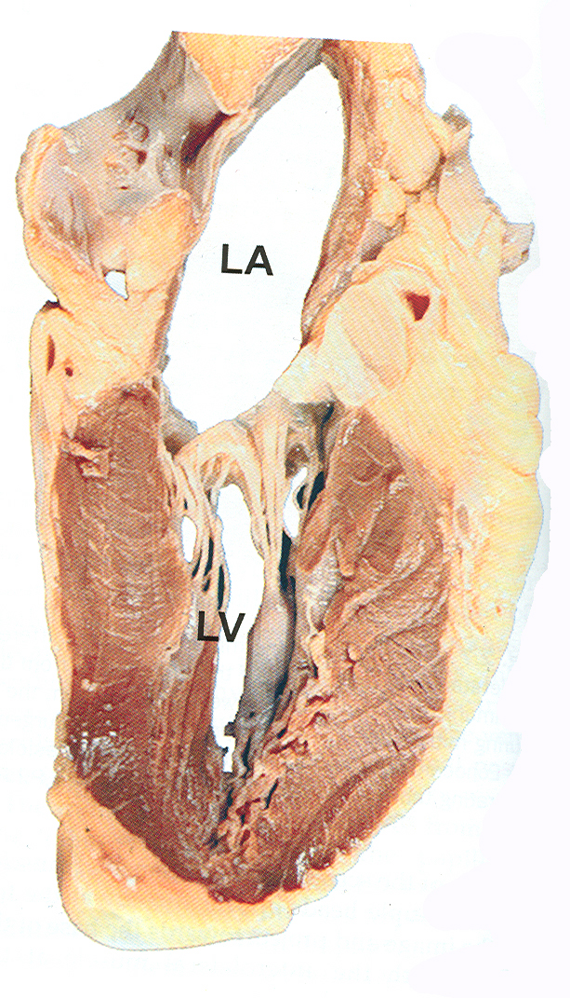
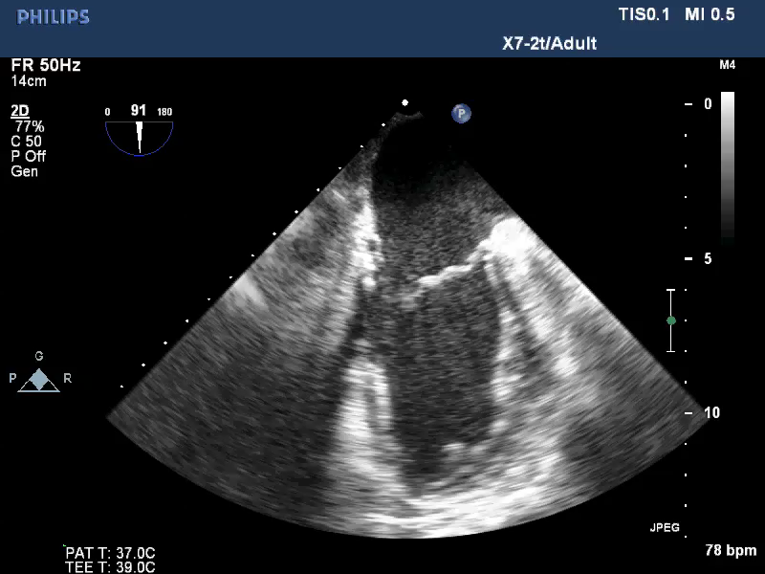
ME 2 Chamber view
INFERIOR WALL
ANTERIOR WALL

Slide 19
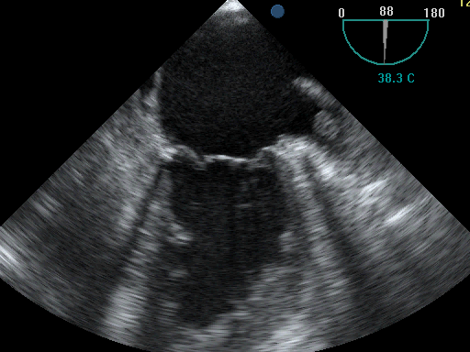
Left Atrial Appendage evaluation
(ME 2C view)

Slide 20
ME LONG AXIS VIEW
From ME 2Ch View rotate multiplane angle to 120-160º
  LVOT and AV will appear
Anteroseptal and Inferolateral LV walls
Apply CFD to MV, LVOT, AV for valvular disease

Slide 21
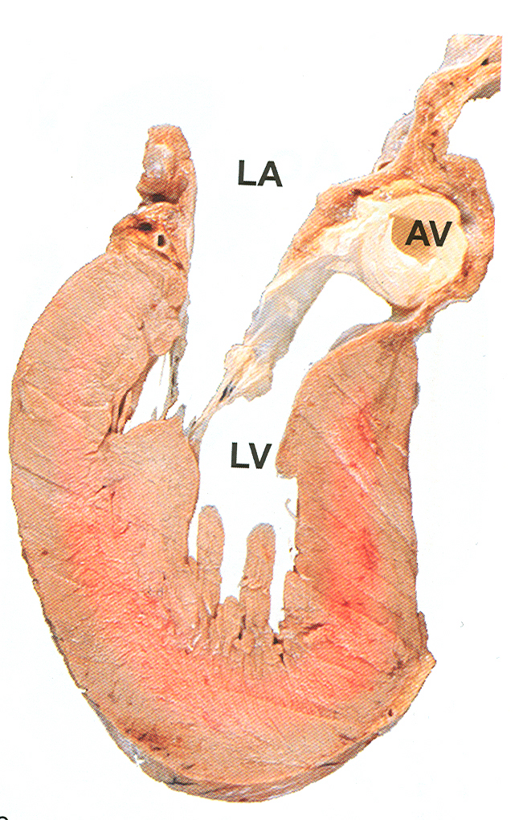
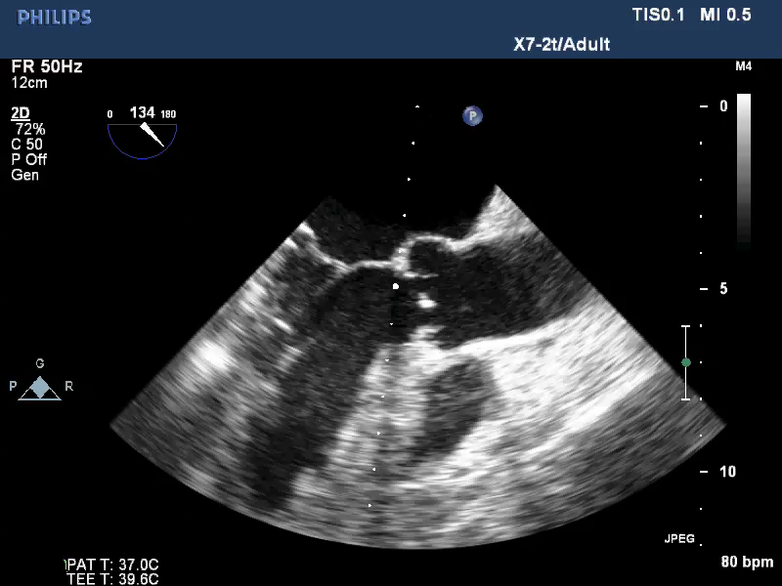
ME Long Axis View
RV
INFERO
LATERAL
ANTERO
SEPTAL

Slide 22
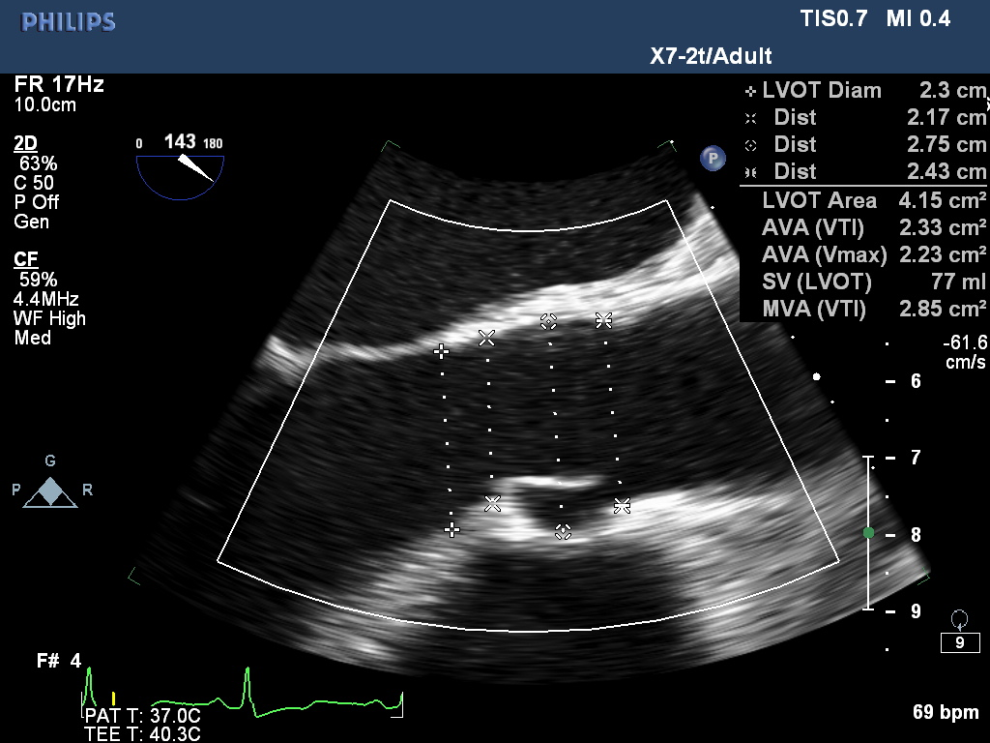
AV Long axis measurements

Slide 23
ME Ascending aortic Long Axis view
From ME LAX view withdraw probe until the long axis view of ascending aorta comes in to view
Right PA will be seen in SAX posterior to ascending aorta

Slide 24
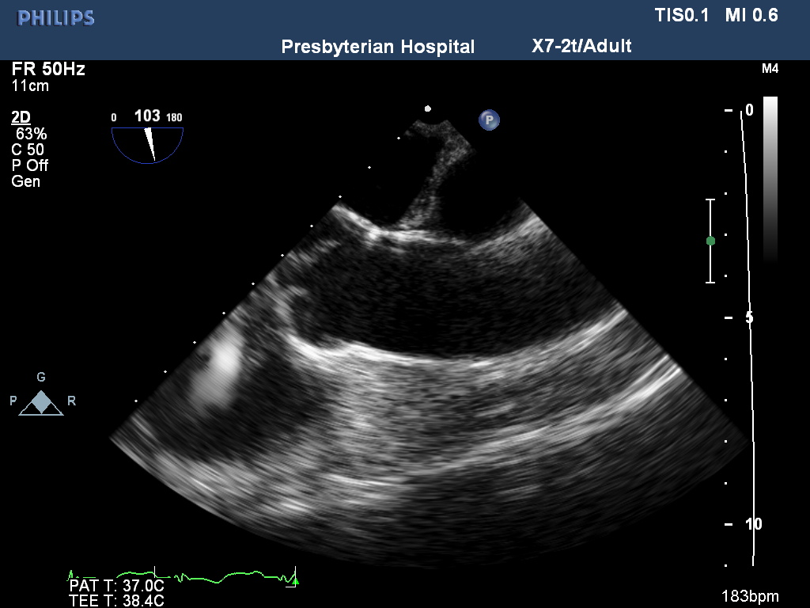
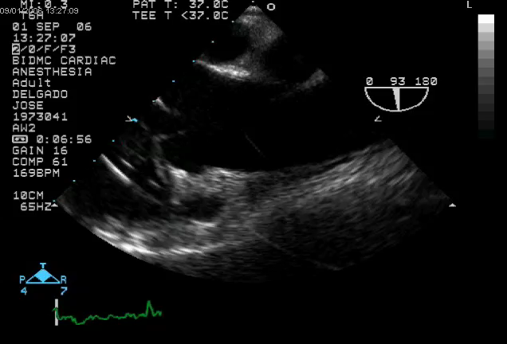
ME Ascending aortic long axis view
RT PA
ASCENDING AORTA

Slide 25
ME Ascending aortic Short Axis View
From ME Asc LAX view, rotating multiplane to 20-40º will reveal the proximal Ascending Aorta and SVC in SAX, bifurcation of PA
Proximal pulmonary emboli in main PA, Saddle, or R PA are sometimes found in this view

Slide 26
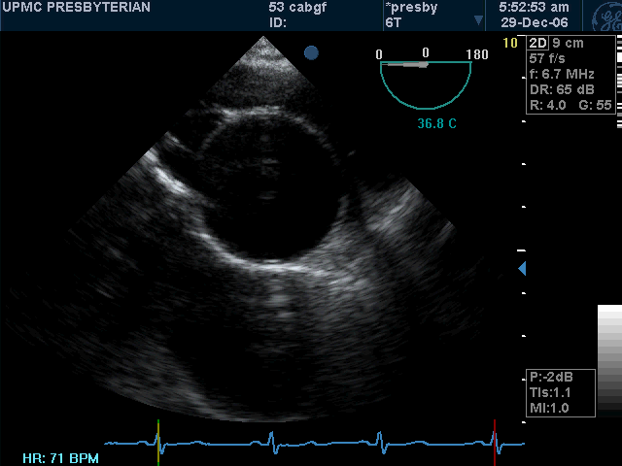
ME Ascending aortic Short Axis

Slide 27
ME Aortic valve short axis
From the ME Asc Aortic SAX view advancing the probe and the multiplane angle to 45-60º will reveal the AV in short axis
All three cusps of the AV can be clearly identified in this view

Slide 28
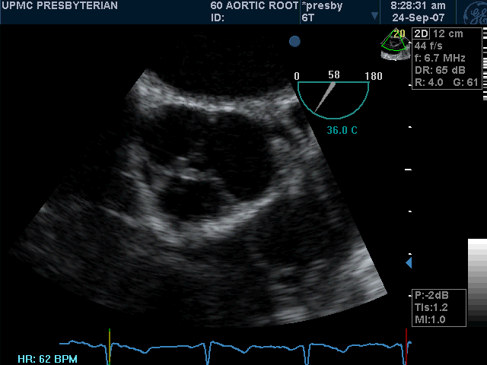
ME Aortic Valve Short Axis

Slide 29
ME RV Inflow-Outflow View
From ME Asc Aortic Valve SAX view, advance and turn probe clockwise while rotating multiplane angle to 60-90º until RVOT and PV seen
Estimate PAPs from TR jet peak velocity in this view
  PAPs = 4v² + RAP

Slide 30
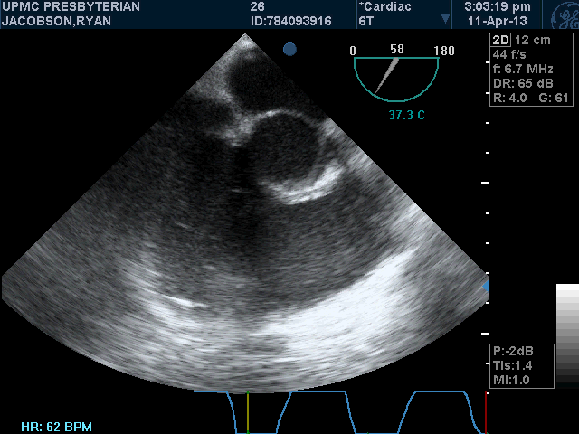
ME RV Inflow-Outflow View

Slide 31
ME Bicaval View
From RV inflow-outflow view rotate multiplane angle to 90-110º to obtain view of SVC and IVC
Catheters, pacing wires in svc and / or entering RA seen here
Evaluation of intra-atrial shunt (PFO, ASD), by CFD and / or ‘bubble’ study
Evaluation of Pulmonary artery systolic pressure

Slide 32
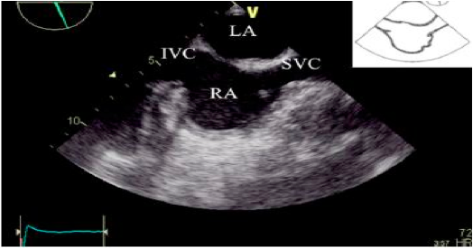
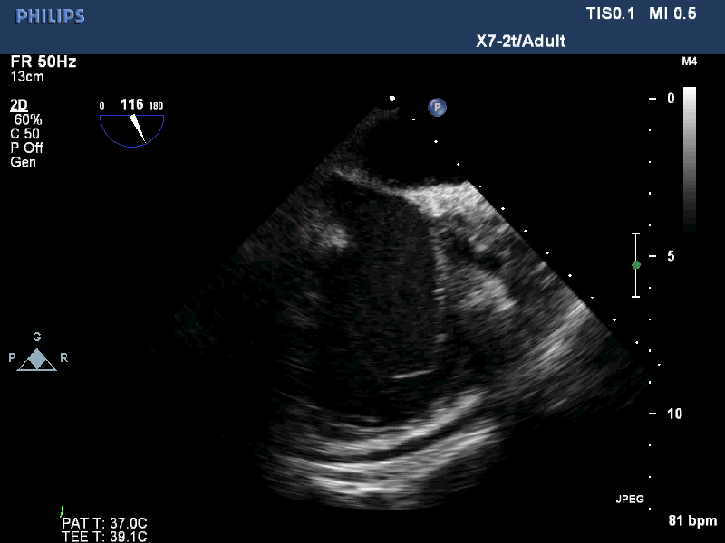
ME Bicaval View

Slide 33
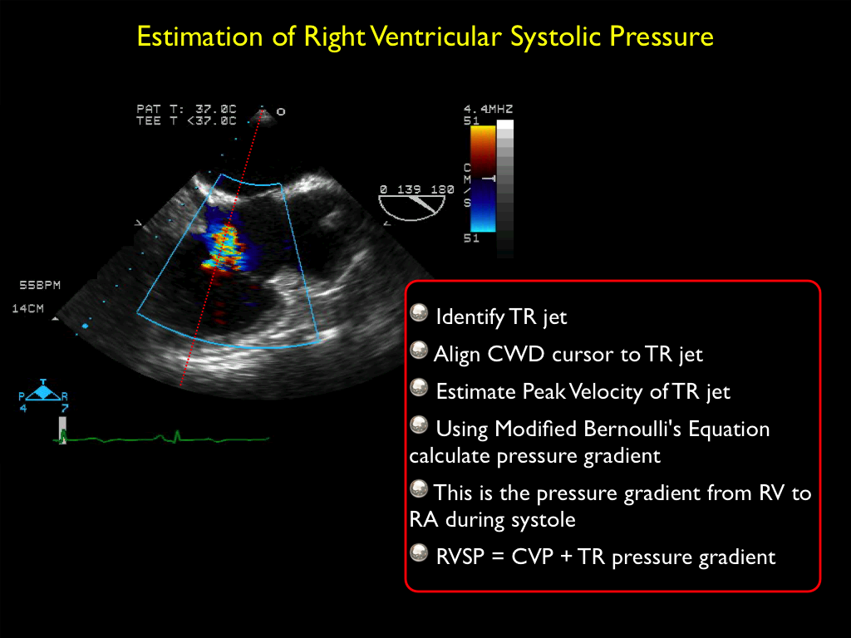

Slide 34
Transgastric Mid-papillary Short Axis
From ME 4Ch view (multiplane angle at zero) advance probe to stomach, anteflex to make contact with gastric wall and view LV in SAX
Extremely important to visualize and identify the papillary muscles; posterior-medial and anterior-lateral papillary muscles
Only view that myocardium supplied by all 3 main coronary arteries are seen
Estimate LVEF, volume status, pericardial effusions, RWMA’s

Slide 35
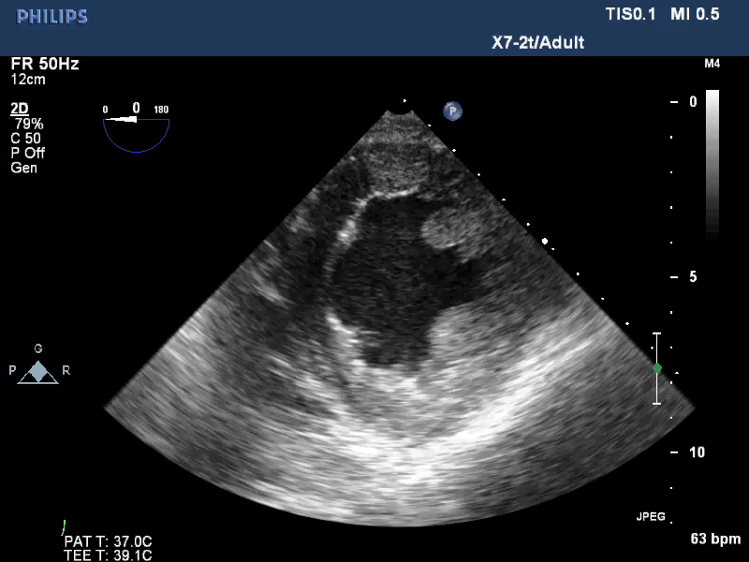

Slide 36
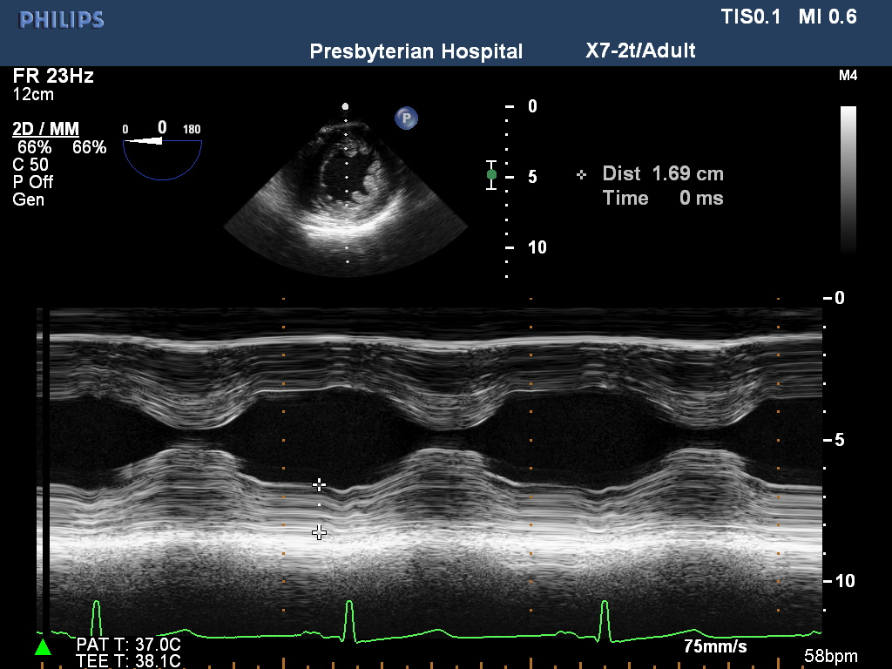

Slide 37
Descending aorta
The descending aorta is easily seen to the left of the heart and therefore from the ME 4Ch view (at 0 degrees) turn the probe to the left (counterclockwise) until the descending thoracic aorta is seen.
With the SAX of the descending thoracic aorta in view, change the multiplane angle to 90º shows the LAX view

Slide 38
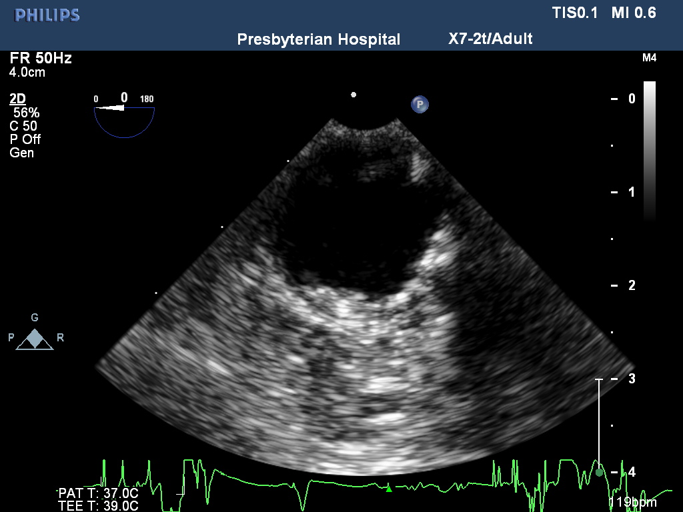
Descending aorta

Slide 39
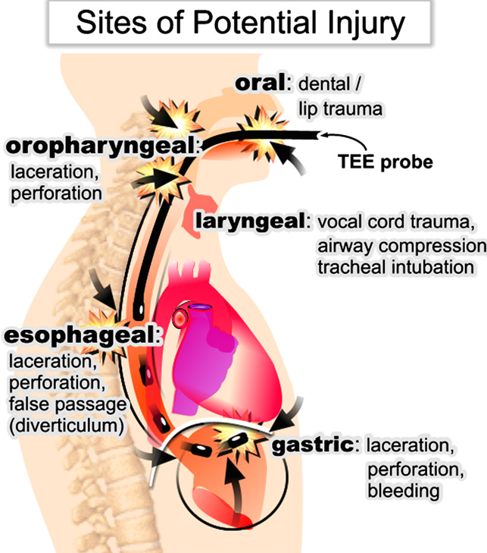
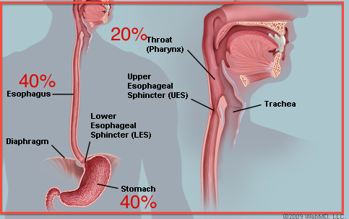
Complications

Slide 40
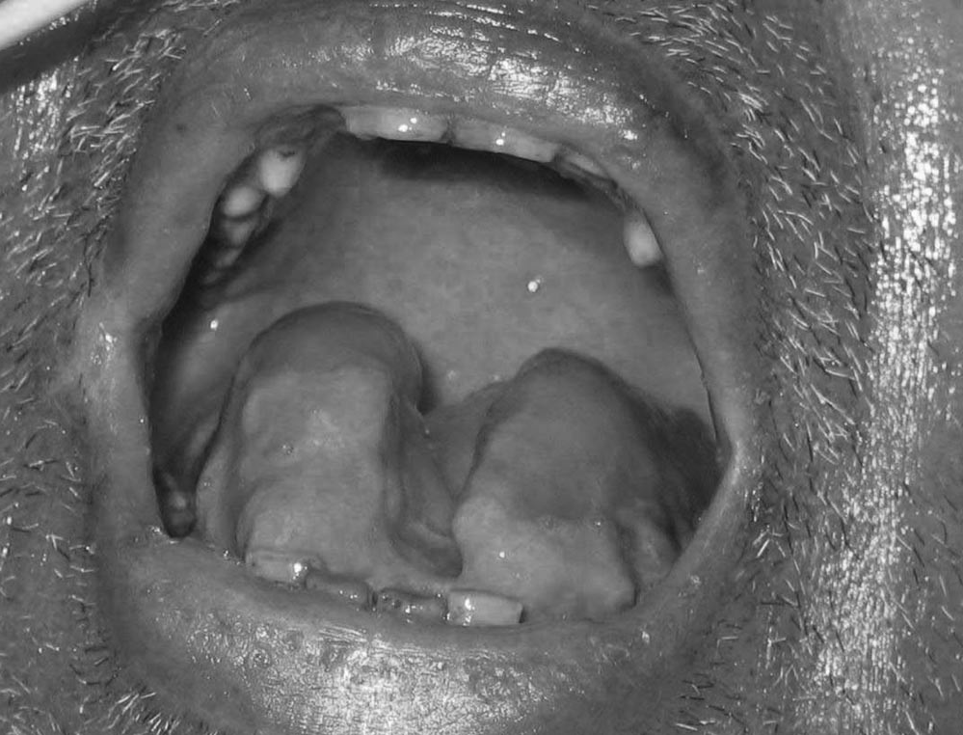
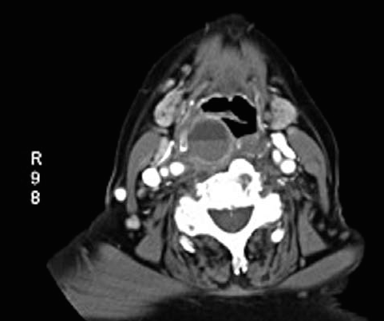

Slide 41
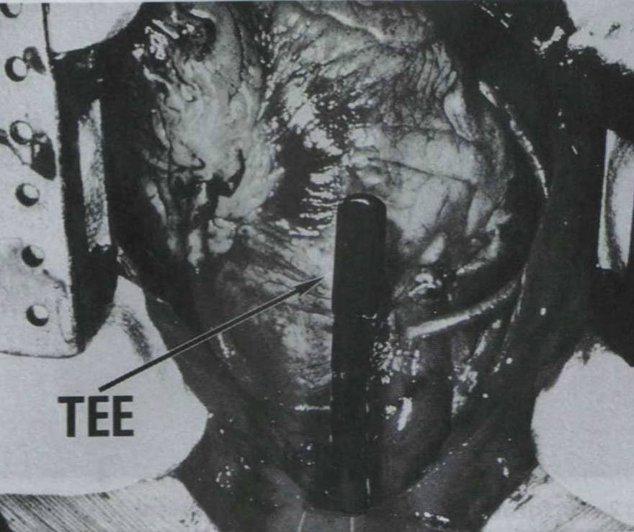
Major injuries
Perforation 1-4 in 10,000 TEE examinations
Mortality 10-56%
Length of time between the perforation and diagnosis determines prognosis

Slide 42
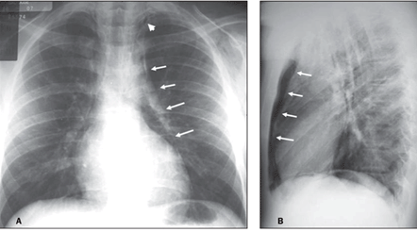

Slide 43
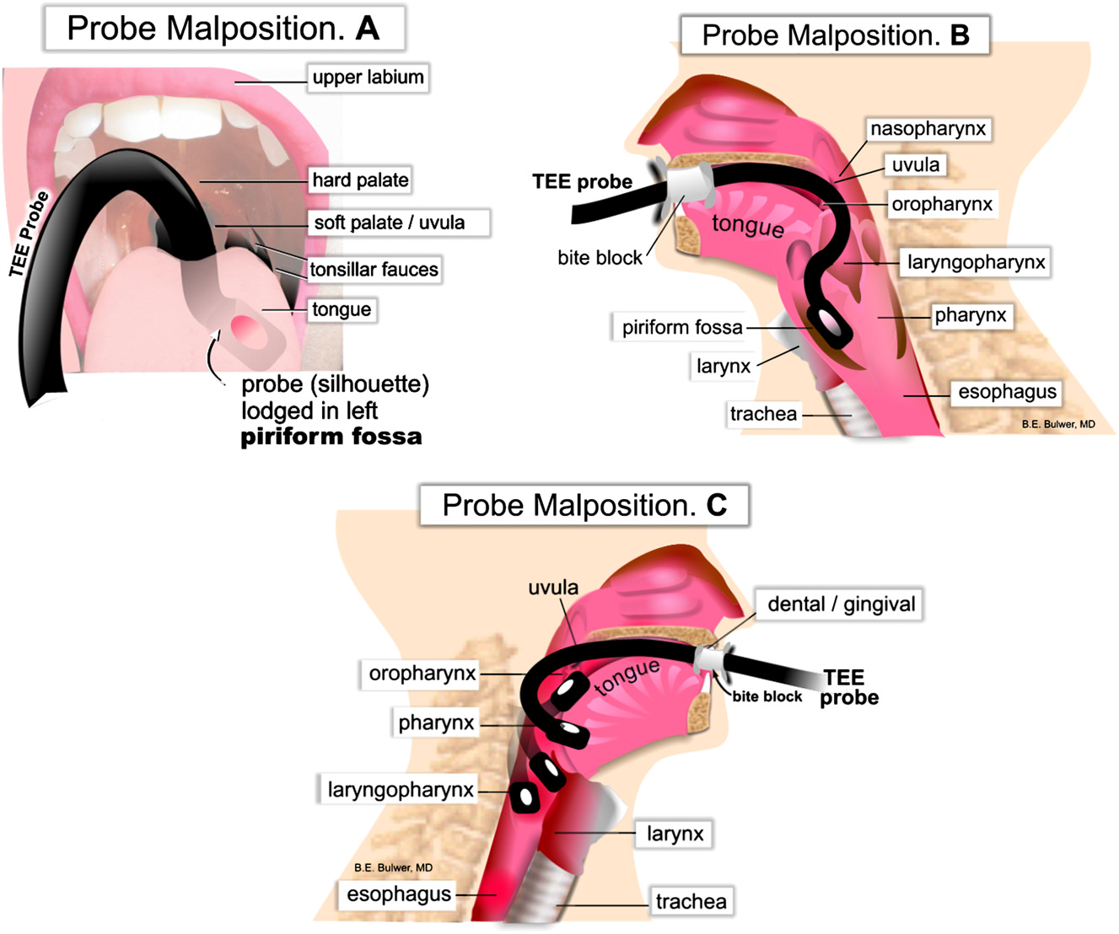
Upper GI injury

Slide 44
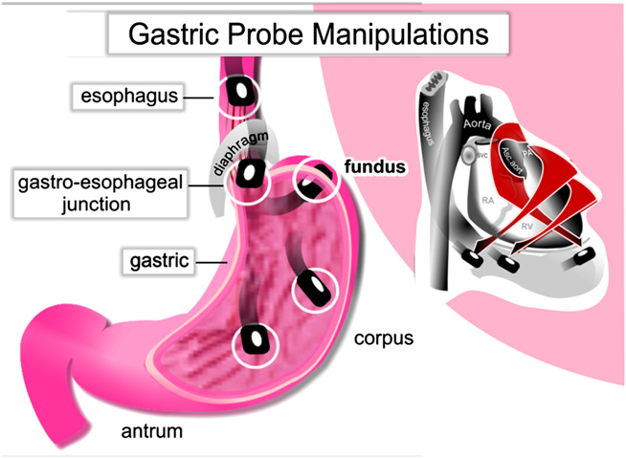
Gastric injuries

Slide 45
Operator factors
Probe not neutral during insertions and advancement
Insertion against resistance
Extreme frequent manipulations (extreme anteflexion) to get good images
Multiple operators rather than a single experienced examination
Limited examination ( ME views only in patients with gastric or GE junction pathology)

Slide 46
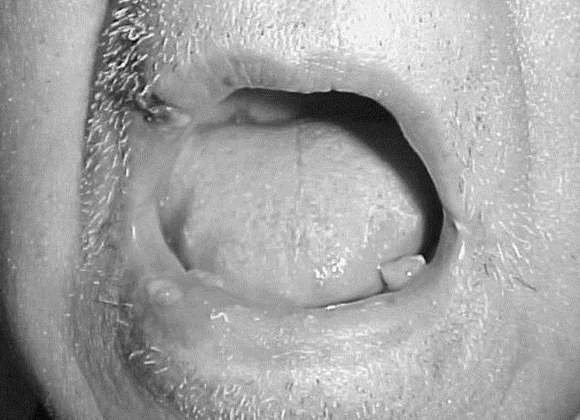
Chemical injury
Venticinque, Steven G. MD*; Kashyap, Vikram S. MD†; O’Connell, Robert J. MD‡. Chemical Burn Injury Secondary to Intraoperative Transesophageal Echocardiography. Anesth Analg 2003;97:1260-1261

Slide 47
BIOSAFETY
INTENSITY OF EXPOSURE (POWER, AMPLITUDE, FREQUENCY)
EXPOSURE TIME
TISSUE PERFUSION
TISSUE DENSITY

Slide 48
Thermal injury
Ultrasound piezo-electric vibrations
Ultrasound energy absorption by tissues- heating of tissues
Doppler and color flow imaging
No strong evidence
Freeze or disconnect probe while not use
Automatic probe off when temperature reached 42-46

Slide 49
Cavitation
Creation or vibration of small gas filled bodies by the ultrasound beam
Expansion and rarefaction of bubbles can cause cell damage
2D IMAGING

Slide 50
Other complications
Endotracheal tube extubation/misplacement
Respiratory (Laryngospasm, Bronchospasm, Aspiration, Desaturation requiring intubation)
Circulatory (Hypertensive response, Cardiac arrhythmias, Aneurysm rupture)

Slide 51
INDICATIONS FOR PERIOPERATIVE TEE
Cardiac surgery
All Cardiac and thoracic aortic procedures
Catheter based intracardiac procedures

Slide 52
Critical Care
TEE should be used when diagnostic information that is expected to alter management cannot be obtained by TTE or other modalities in a timely manner

Slide 53
Non-cardiac surgery
TEE should be used when unexplained life threatening circulatory instability persists despite corrective therapy (Treatment)
TEE may be used when the nature of the planned surgery or the patient’s known or suspected cardiovascular pathology might result in severe hemodynamic/pulmonary/neurologic compromise (Prevention)

Slide 54
THANK YOU VERY MUCH!

